Slide 1
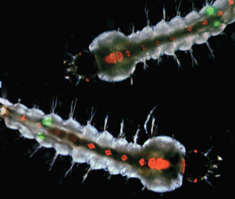
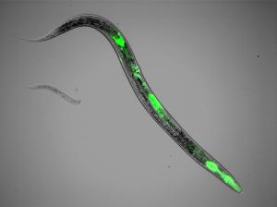
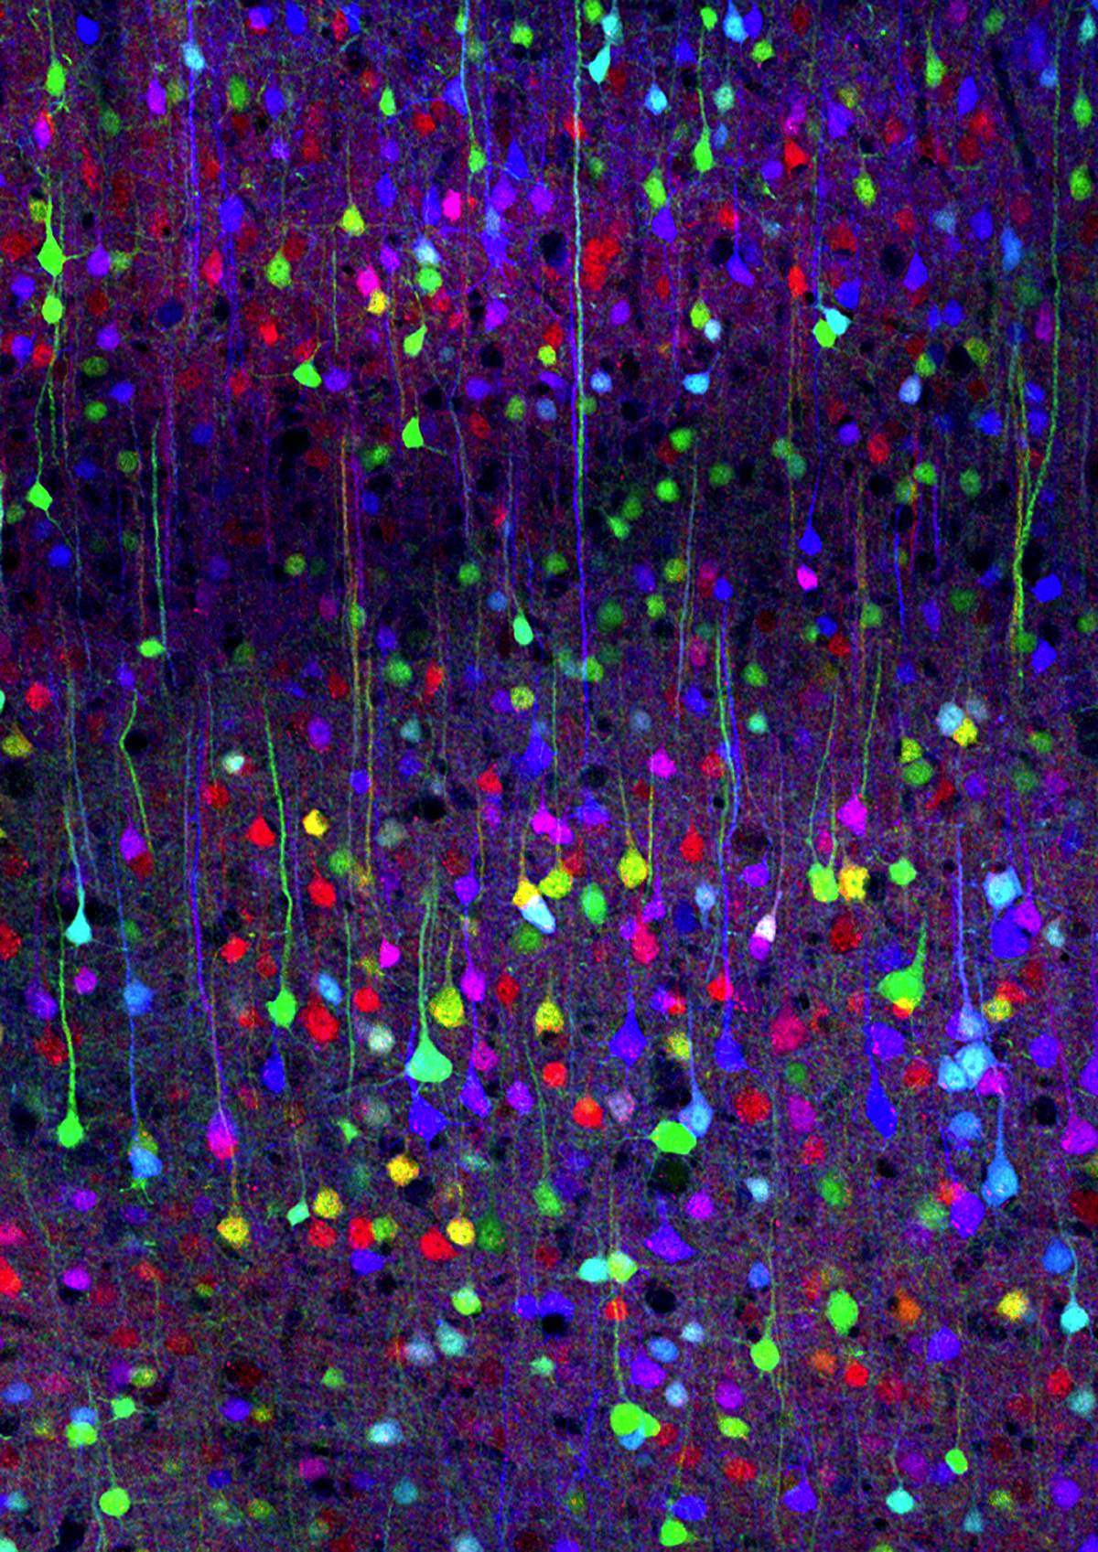
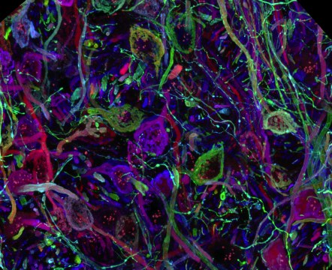
Illuminating Disease from Constipated Worms to Fluorescent Mosquitoes Marc Zimmer Connecticut College
Gen

Slide 2
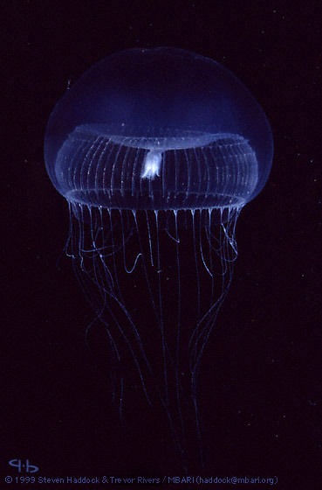
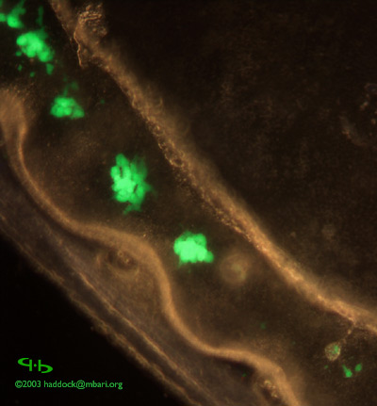

Slide 3


Slide 4
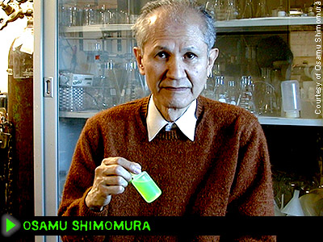

Slide 5


Ca2+
Aequorin
GFP

Slide 6
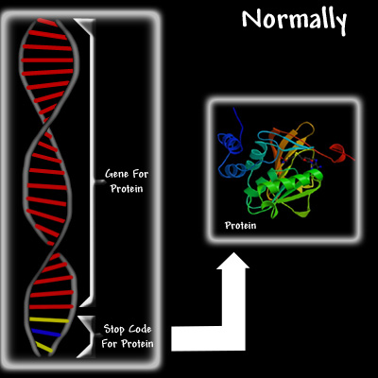
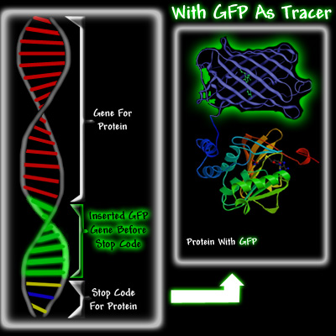

Slide 7

Connecticut College

Slide 8

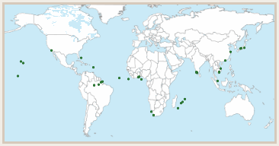
Semester at Sea
Notes:
Of 7,500 study away prorams

Slide 9
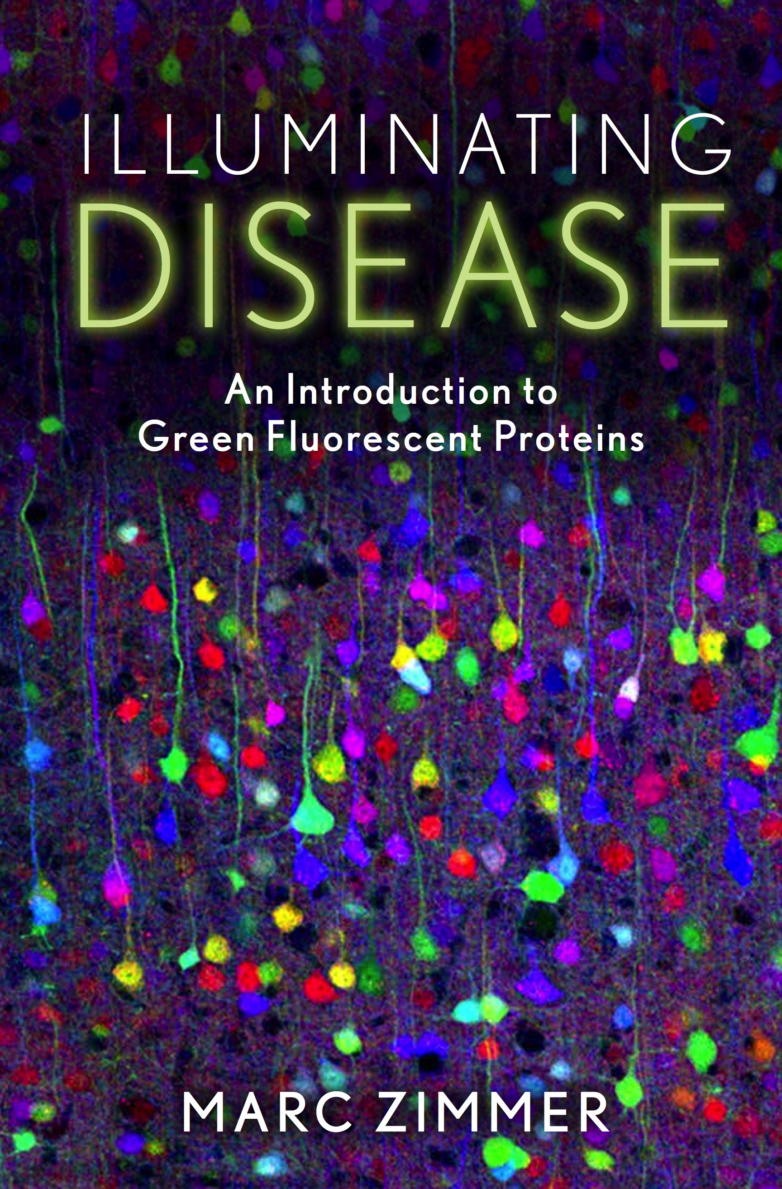

Slide 10
Heart Disease
Heart Disease in the US in 2010 Non-institutionalized adults with diagnosed heart disease: 27.1 million
Hospital discharges with heart disease as first-listed diagnosis: 4.0 million
Average length of stay: 4.6 day
Number of deaths: 599,413
Cause of death rank: 1
“Thus nature, ever perfect and divine, doing nothing in vain, has neither given a heart where it was not required, nor produced it before its office had become necessary; but by the same stages in the development of every animal, passing through the forms of all, as I may say (ovum, worm, foetus), it acquires perfection in each. These points will be found elsewhere confirmed by numerous observations on the formation of the foetus. Finally, it is not without good grounds that Hippocrates in his book, "De Corde," entitles it a muscle; its action is the same; so is its functions, viz., to contract and move something else -- in this case the charge of the blood.”
William Harvey in On the Motion of the Heart and Blood in Animals (1889)

Slide 11
Rhythm Gene Discovered: The Scoop On When Worms Poop,
Ovulate And Swallow
Maricq, Cell, 2005, 123, 119 C.elegans Utah University
Notes:
Roundworm - 959 cells, 65% similar, bottom = mouth; regular = 45-50s …..up to 10 minutes ; 0.05% male ; hypertension || humans

Slide 12
Yasuhiko Kawakami University of Minnesota
Development 2012, 139, 4133-4142.
Notes:
Energy, ATP, O2, ---blockage --- cell death….stem cells
Kaede

Slide 13
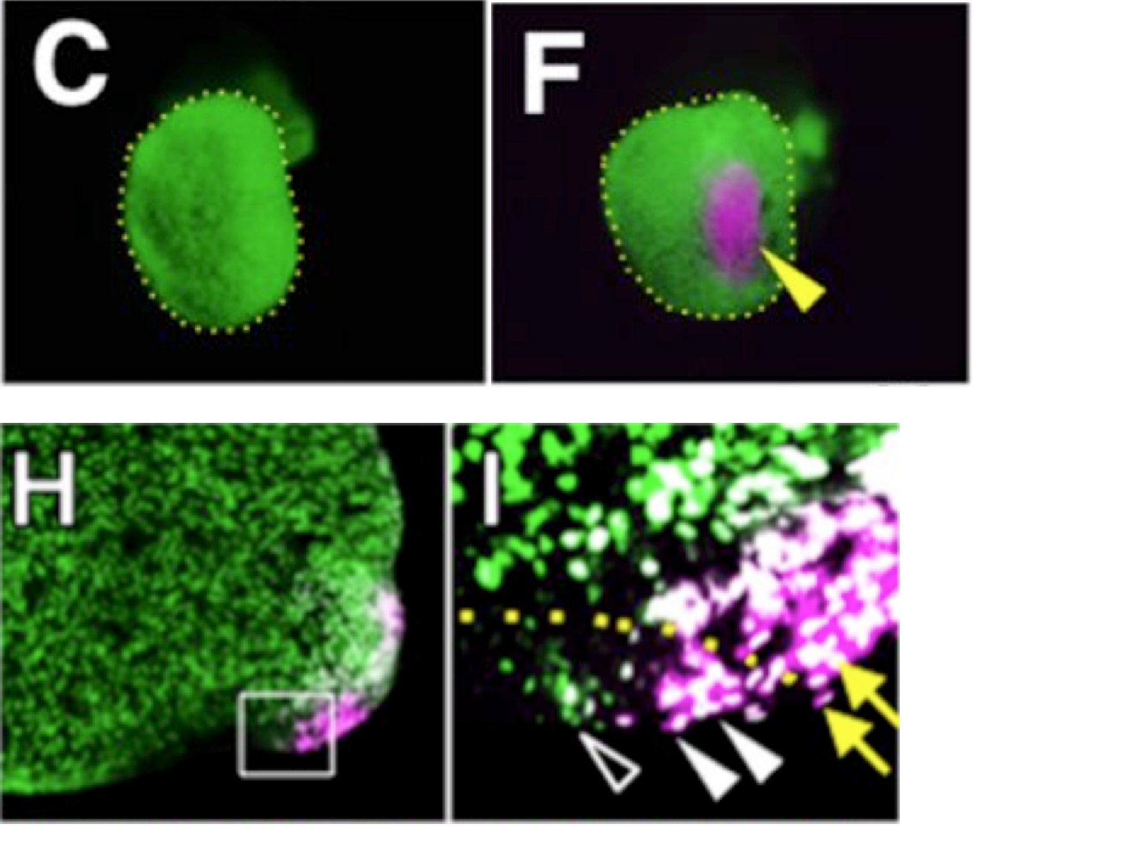
Yasuhiko Kawakami University of Minnesota
Development 2012, 139, 4133-4142.

Slide 14
Hina Chaudhry Mount Sinai
Circulation Research 2011, 110, 82-93.
Notes:
Mothers better survival rates

Slide 15
Dengue Fever
Countries with severe dengue epidemics Year 9 1970
127 2011
It is a virus, carried by a mosquito, and begins as a headache of such voltage that you tremble and can’t stand or sit. You’re knocked flat; your muscles ache, you’re doubled-up with cramp and your temperature stays over a hundred. Then your skin becomes paper-thin, sensitive to the slightest touch –the weight of a sheet can cause pain. And your hair falls out – not all of it, but enough to fill a comb. These severe irritations produce another agony, a depression so black the dengue sufferer continually sobs. All the while your bones ache, as if every inch of you has been smashed with a hammer.
Dengue Fever, The Collected Stories, Paul Theroux

Slide 16
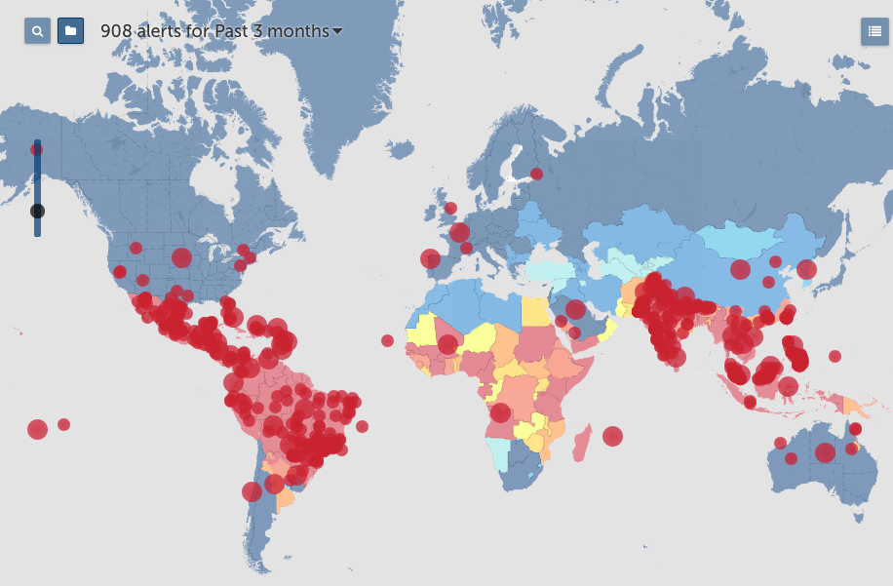

Slide 17
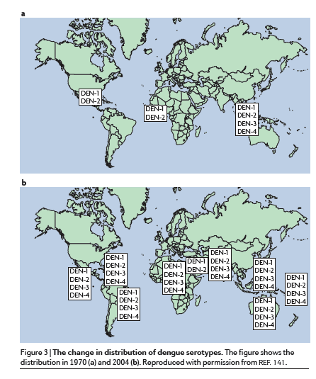

Slide 18
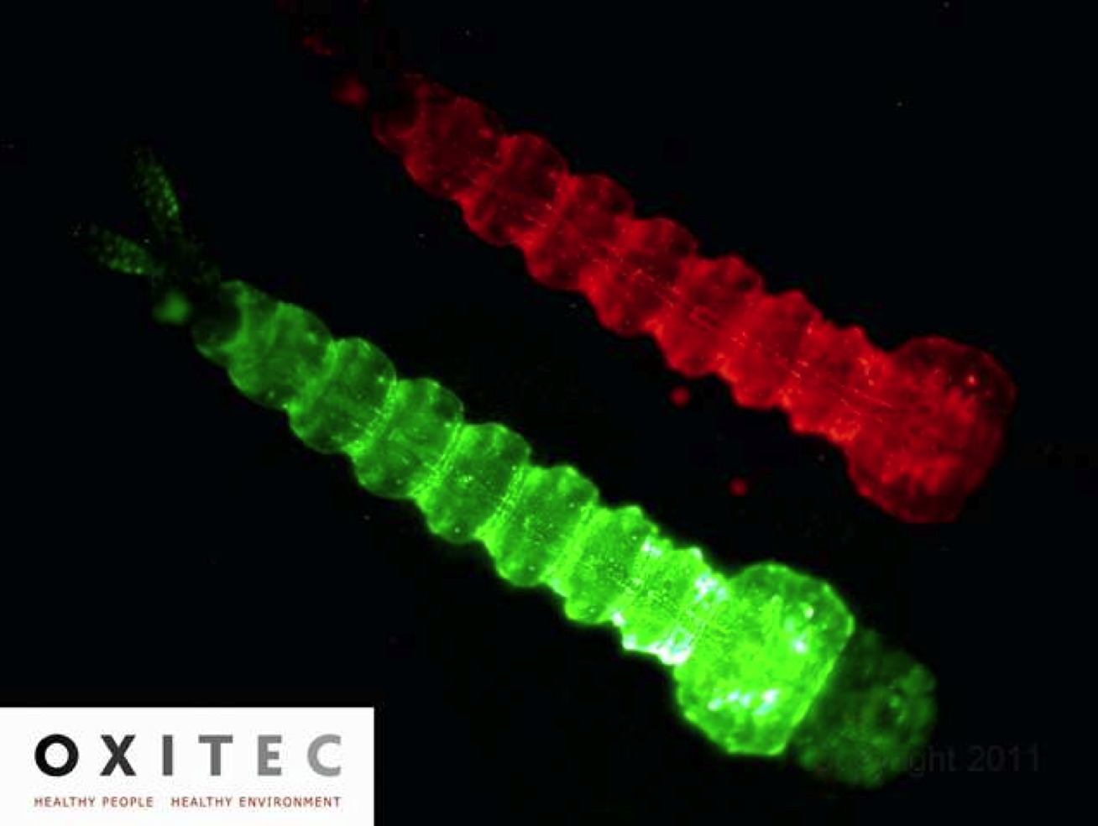
Notes:
Dengue huge problem in Florida 100 years ago. DDT but …..

Slide 19
Malaria
Malaria Fatalities, 2010
Worldwide 655,000
Africa 596,000
America 1,000
Children under 5 years of age 563,000
Their bite is as painful as that of the serpents, and causes diseases... [The wound] as if burnt with caustic or fire, is red, yellow, white, and pink color, accompanied by fever, pain of limbs, hair standing on end, pains, vomiting, diarrhea, thirst, heat, giddiness, yawning, shivering, hiccups, burning sensation, intense cold...
Dhanvantari, 800 B.C.

Slide 20
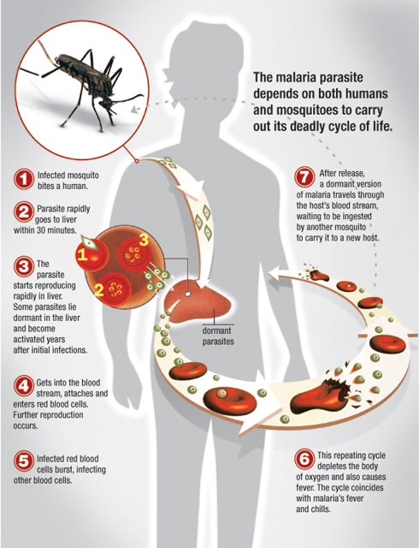

Slide 21
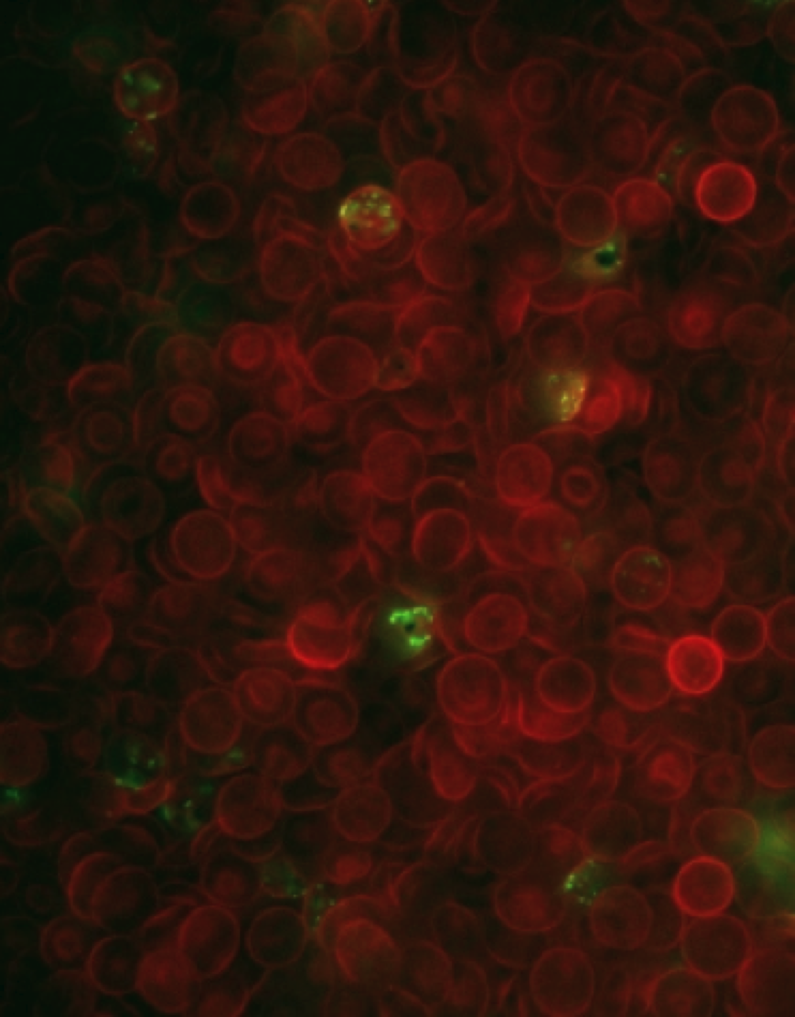
Notes:
Some of the red blood cells shown in this photograph are infected with GFP expressing P. falciparum. The cells infected by the malaria parasite collapse -- lose their doughnut shape and became rigid sickle shaped cells , protecting the human host against malaria

Slide 23
Chagas
Worldwide (infected) 10 -18 million
United States (infected) 300,000
Develop chronic cardiac problems 30%
Develop chronic gastric problems 10%
“Endemic Chagas disease has emerged as an important health disparity in the Americas. As a result, we face a situation in both Latin America and the US that bears a resemblance to the early years of the HIV/AIDS pandemic.”
Editorial in PLOS Neglected Disease, May 2012
After hookworm, it is the most common disease afflicting the estimated 99 million people who live on less than $2 a day in the Latin American and Caribbean region.
In 2008 globally no more than $15.6 million was spent on Chagas research and less than five million dollars of that money was used for finding new diagnostics, drugs and vaccines
Notes:
After hookworm, it is the most common disease afflicting the estimated 99 million people who live on less than $2 a day in the Latin American and Caribbean region. In 2008 globally no more than $15.6 million was spent on Chagas research and less than five million dollars of that money was used for finding new diagnostics, drugs and vaccines

Slide 24
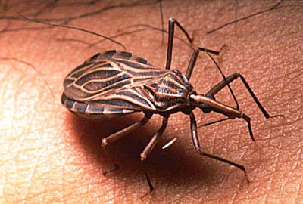
Notes:
Kissing bugs hide out in dark protected places like cracks in the walls of poorly constructed homes and thatch roofs. More than 14,000 kissing bugs can be found in a single chronically infested home.(2) At night they leave their hidey-holes, and like female mosquitoes, follow the plumes of carbon dioxide exhaled by their sleeping victims. Once they have found their victims, the kissing bugs unfold their hair-like probisci and have a leisurely five to ten minute meal.

Slide 25
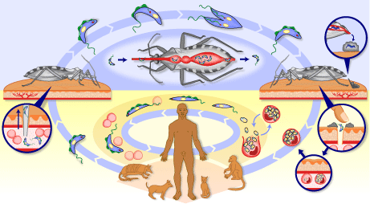
Notes:
T. cruzi

Slide 26

Notes:
20

Slide 27
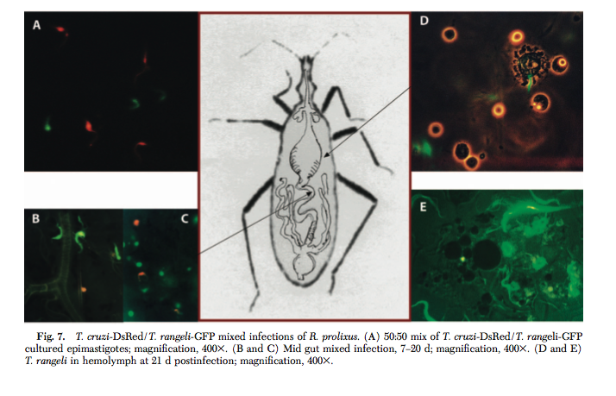
Palmira Guevara U. Central Venezuela
J. Med. Entomology 2005, 42, 48-56. l

Slide 28
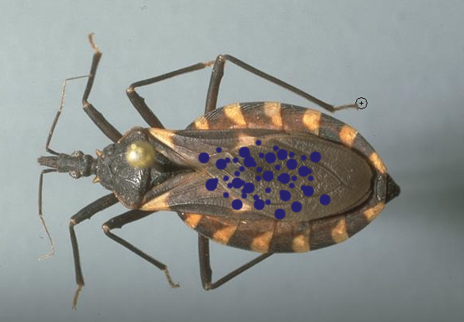
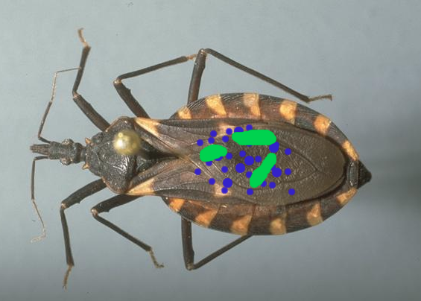
T. cruzi enters kissing bug
Kissing Bug infected with bacteria

Slide 29
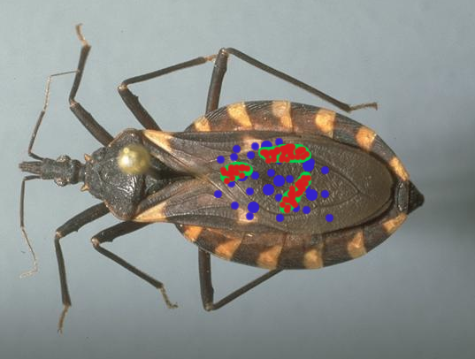
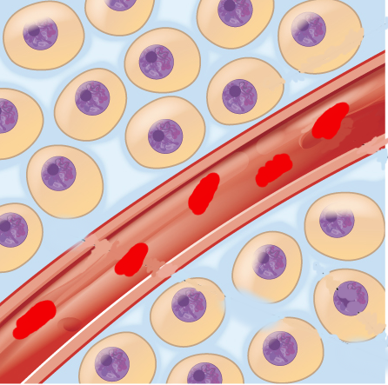
Bacteria excrete DsRed sugar-binders that engulf T. cruzi
T. cruzi cannot enter cells

Slide 30
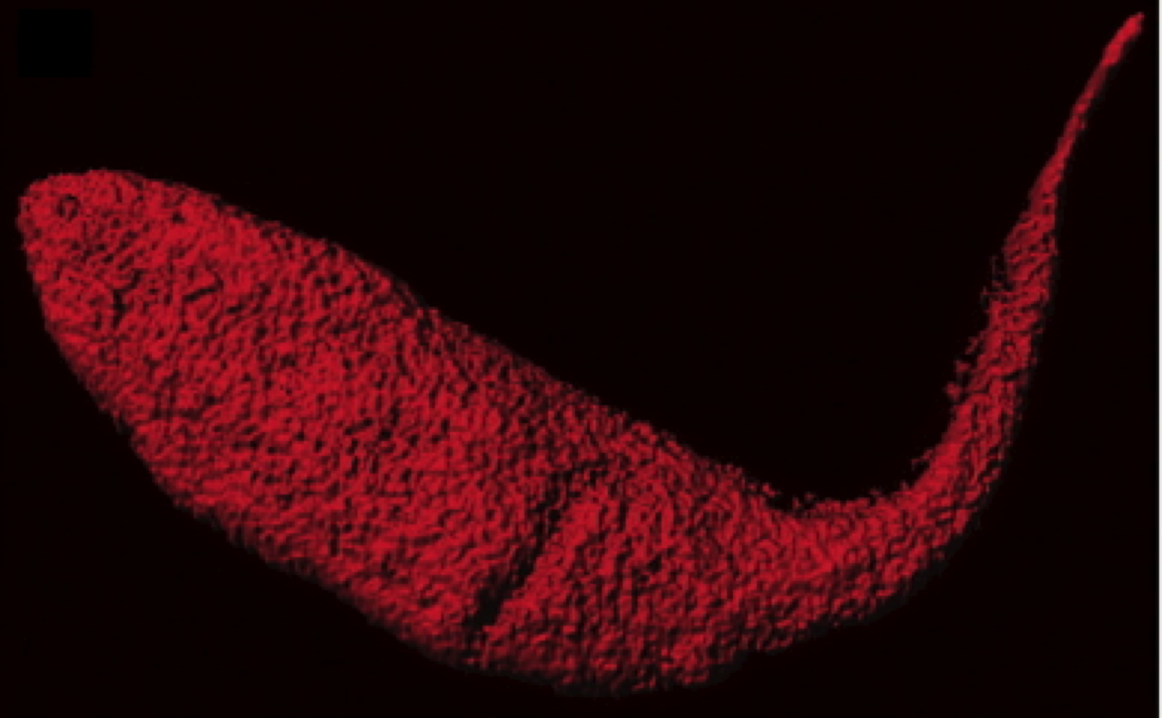
Ravi Durvasula University of New Mexico, 2011
Notes:
Cruziguard

Slide 31
Cancer (USA 2012)
Male Female Total
Estimated New Cases 848,170 790,740 1,638,910
Estimated Deaths 301,820 275,370 577,190

Slide 32
Bob Hoffman Anticancer Inc.

Slide 33
Bob Hoffman Anticancer Inc.

Slide 34
In vivo internal tumor illumination by telomerase-dependent adenoviral GFP for precise surgical navigation, Proceedings of the National Academy of Sciences 2009, 106, 14514-14517.

Slide 35
Brain Disease People Currently Living with Disorder in the United States
Alzheimer’s 4,000,000
Parkinson’s 1,000,000
Huntington’s 30,000
ALS 25,000
And men ought to know that from nothing else but thence [from the brain] come joys, delights, laughter and sports, and sorrows, griefs, despondency, and lamentations. And by this, in an especial manner, we acquire wisdom and knowledge, and see and hear, and know what are foul and hat are fair, what are bad and what are good, what are sweet, and what unsavory... And by the same organ we become mad and delirious, and fears and terrors assail us... All these things we endure from the brain, when it is not healthy.
Hippocrates
The Genuine Works of Hippocrates, trans. Francis Adams (1886), Vol. 2, 344-5.

Slide 36
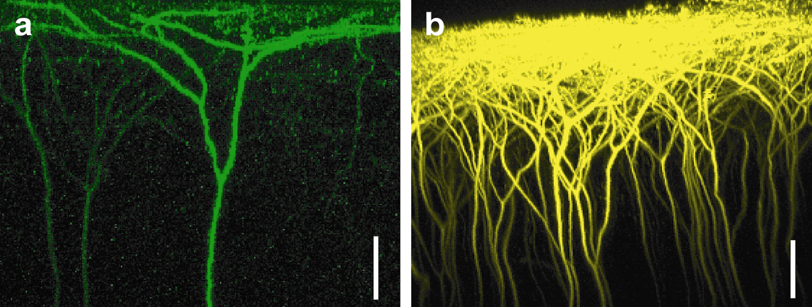


Slide 37
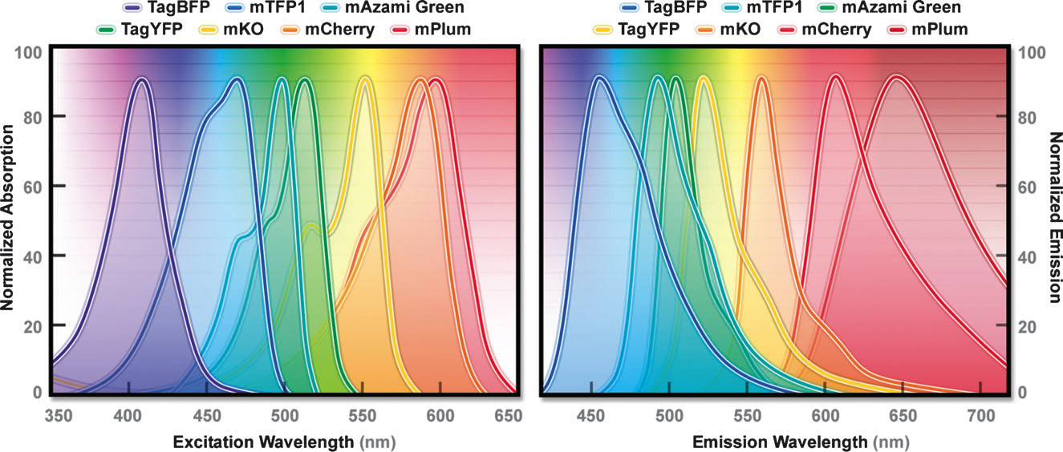
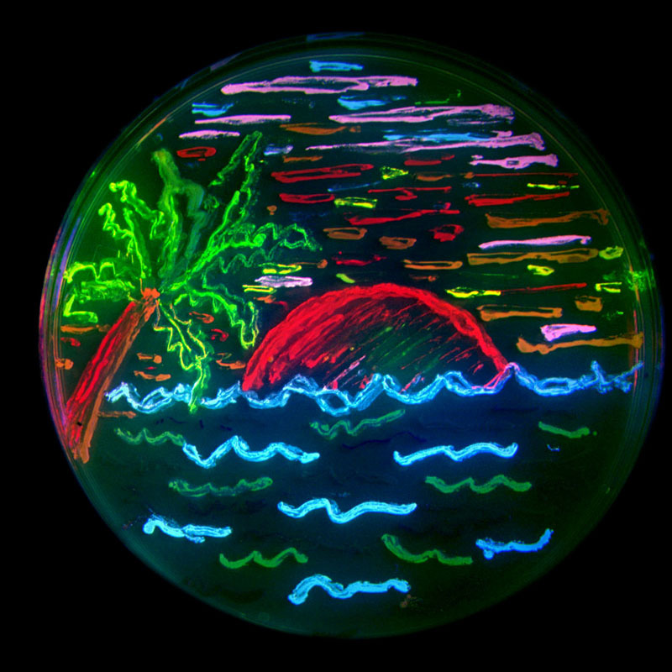
Davidson Chem Soc Rev 2009, 38, 2887
Credit: Tsien

Slide 38
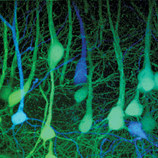

Slide 39
_{Cerebral cortex.}
(Confocal image by Tamily Weissman. Mouse by Jean Livet and Ryan Draft.)

Slide 40
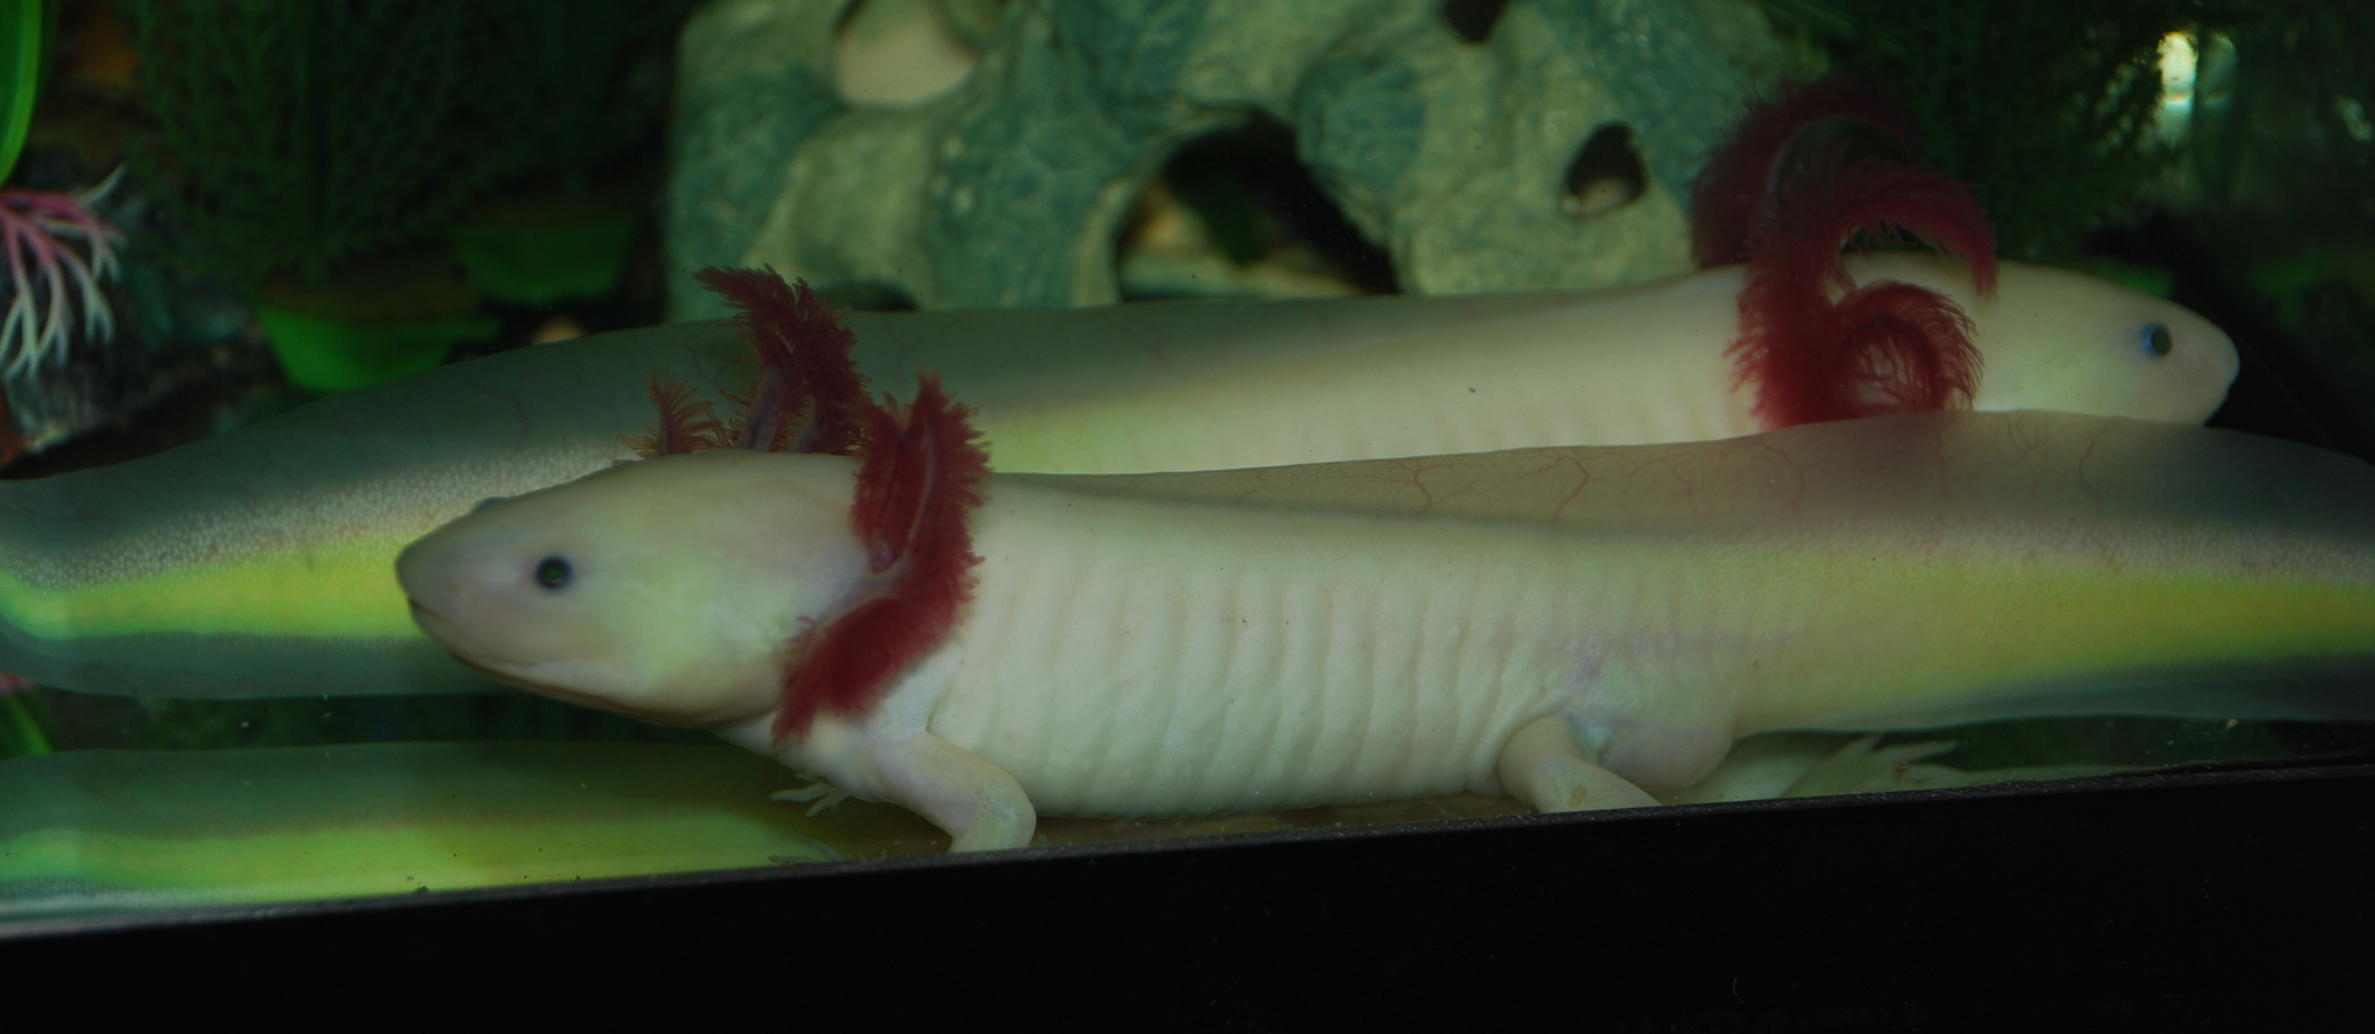
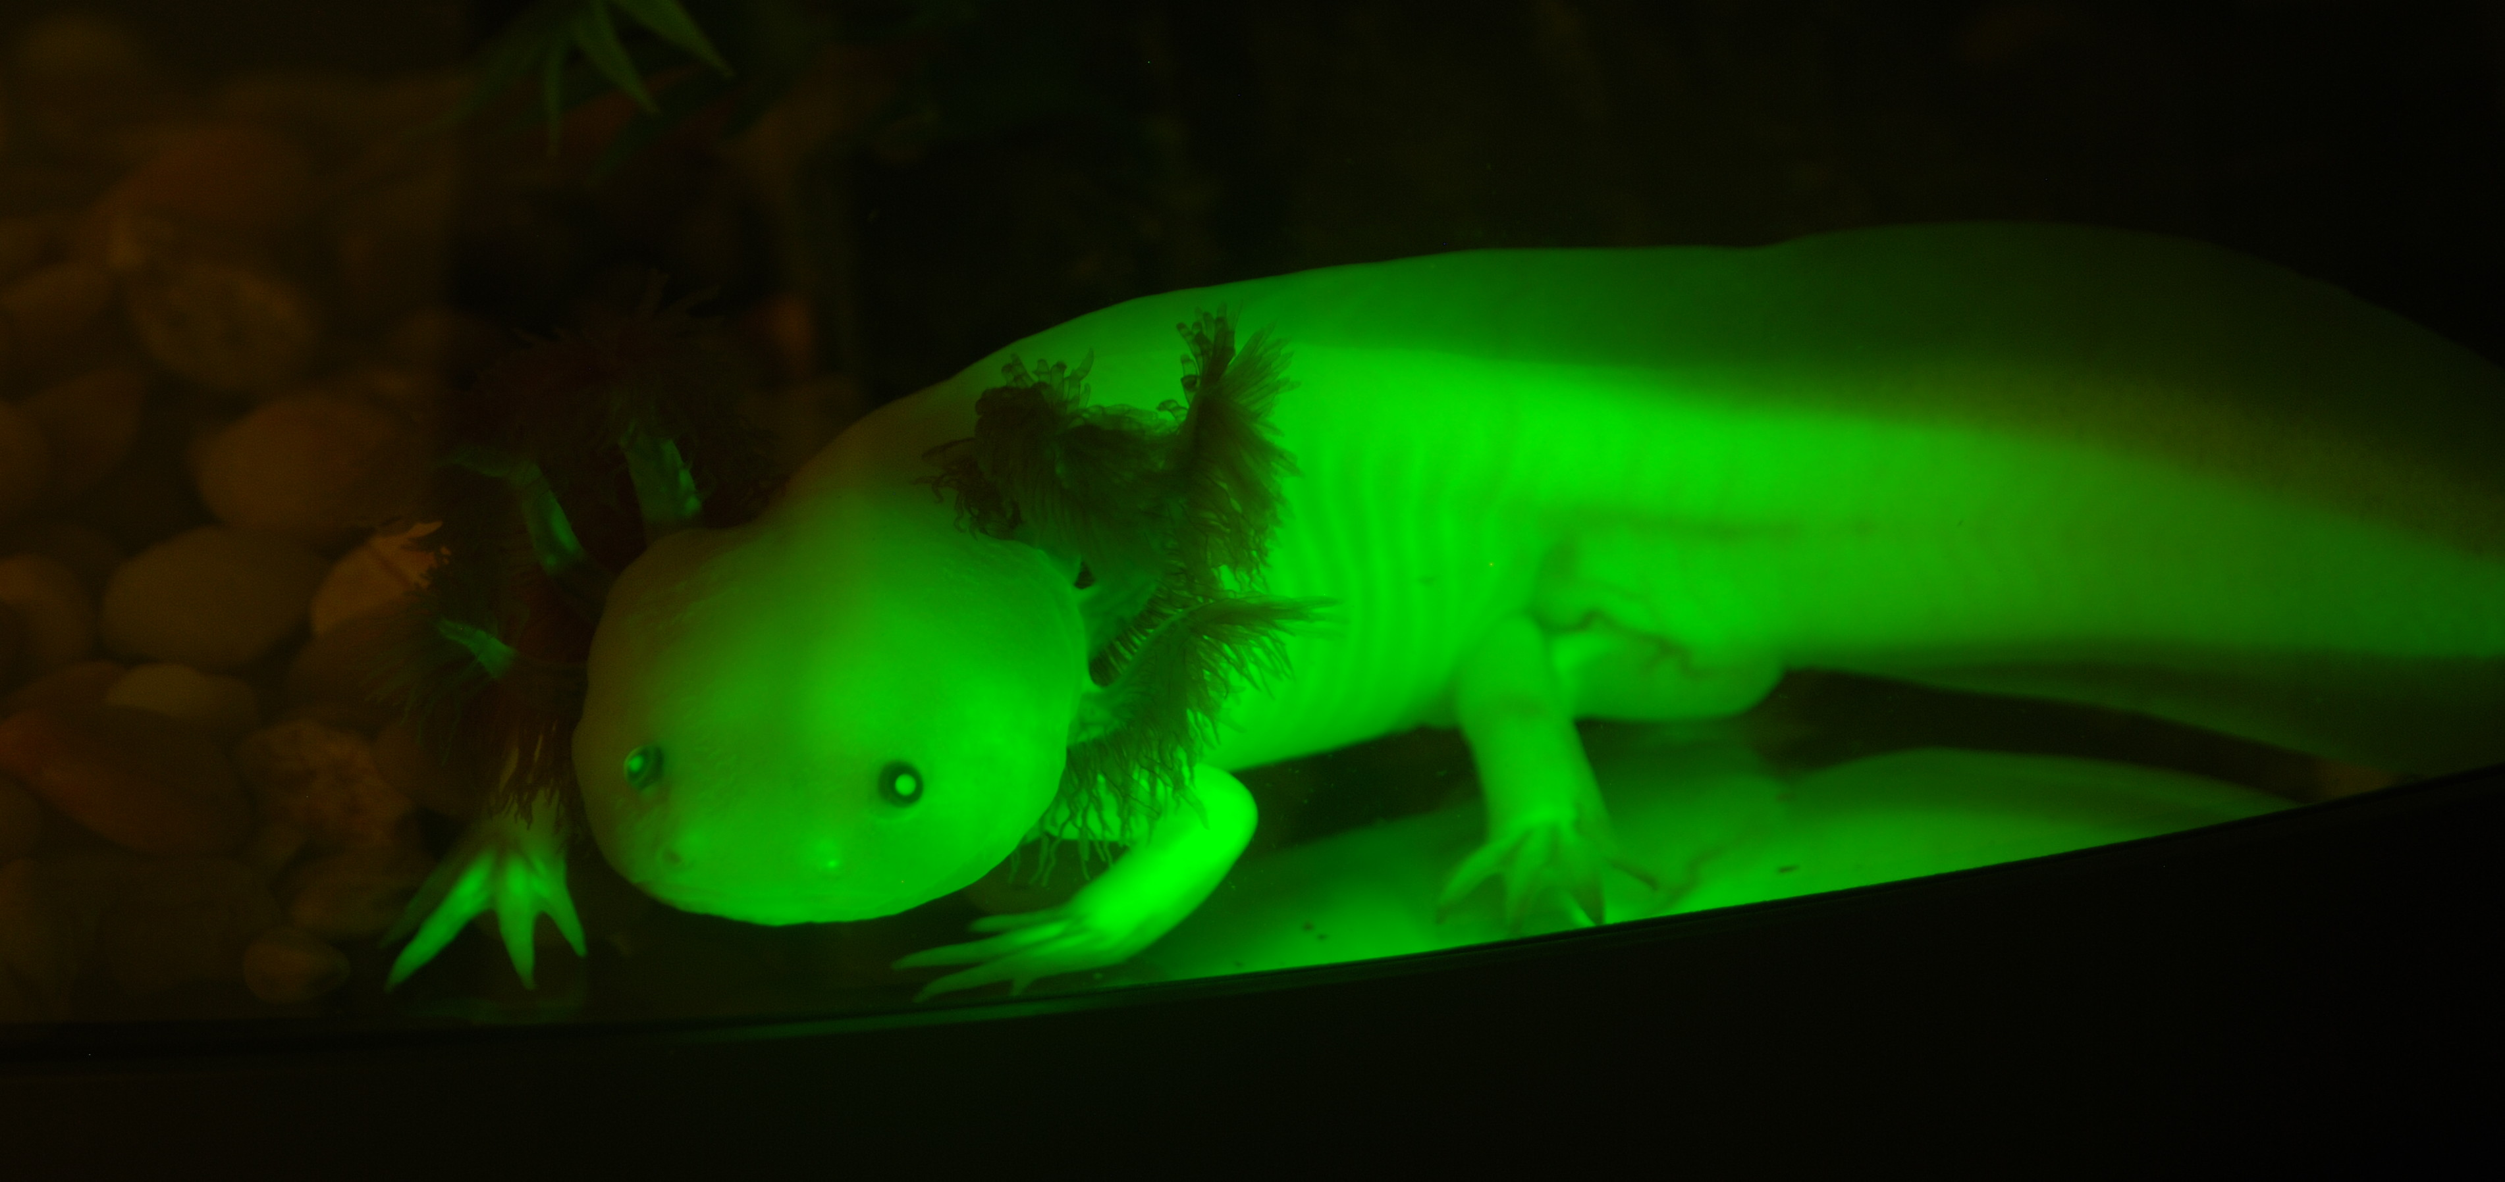

Slide 41
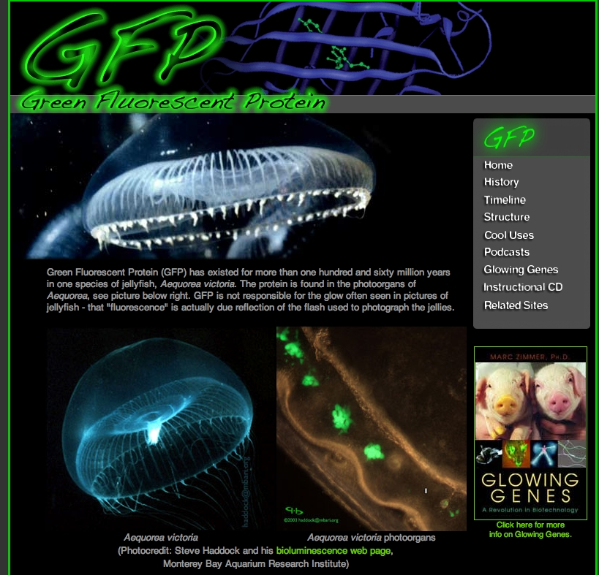
http://gfp.conncoll.edu

Slide 42
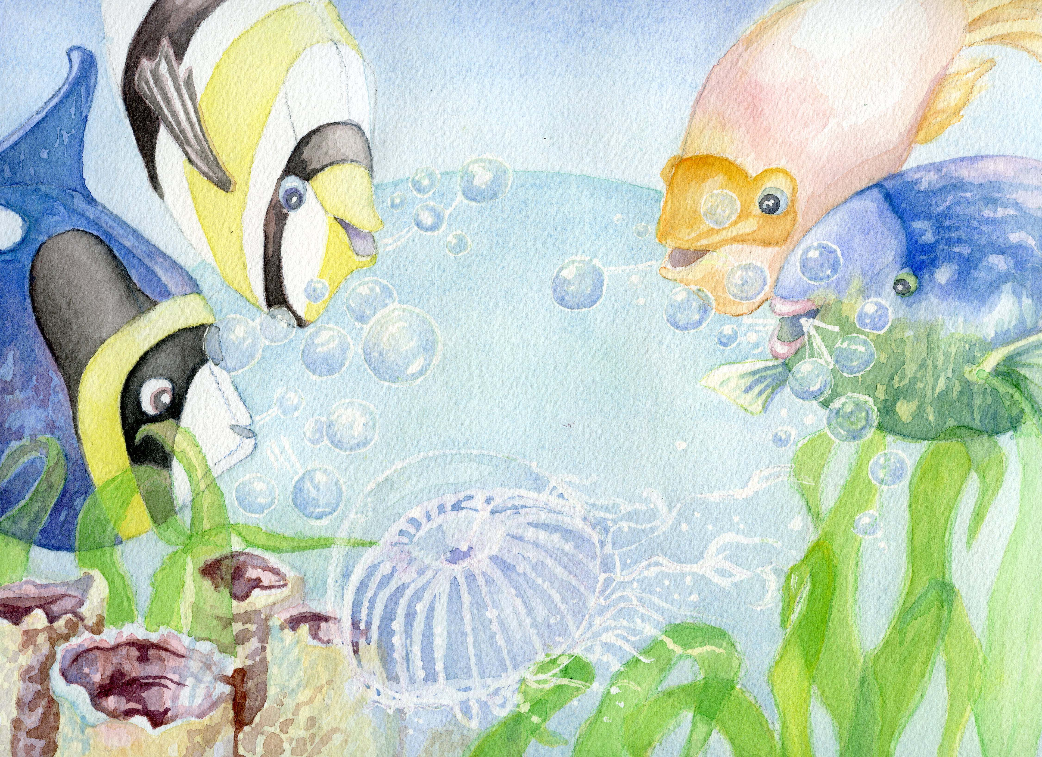

Slide 43
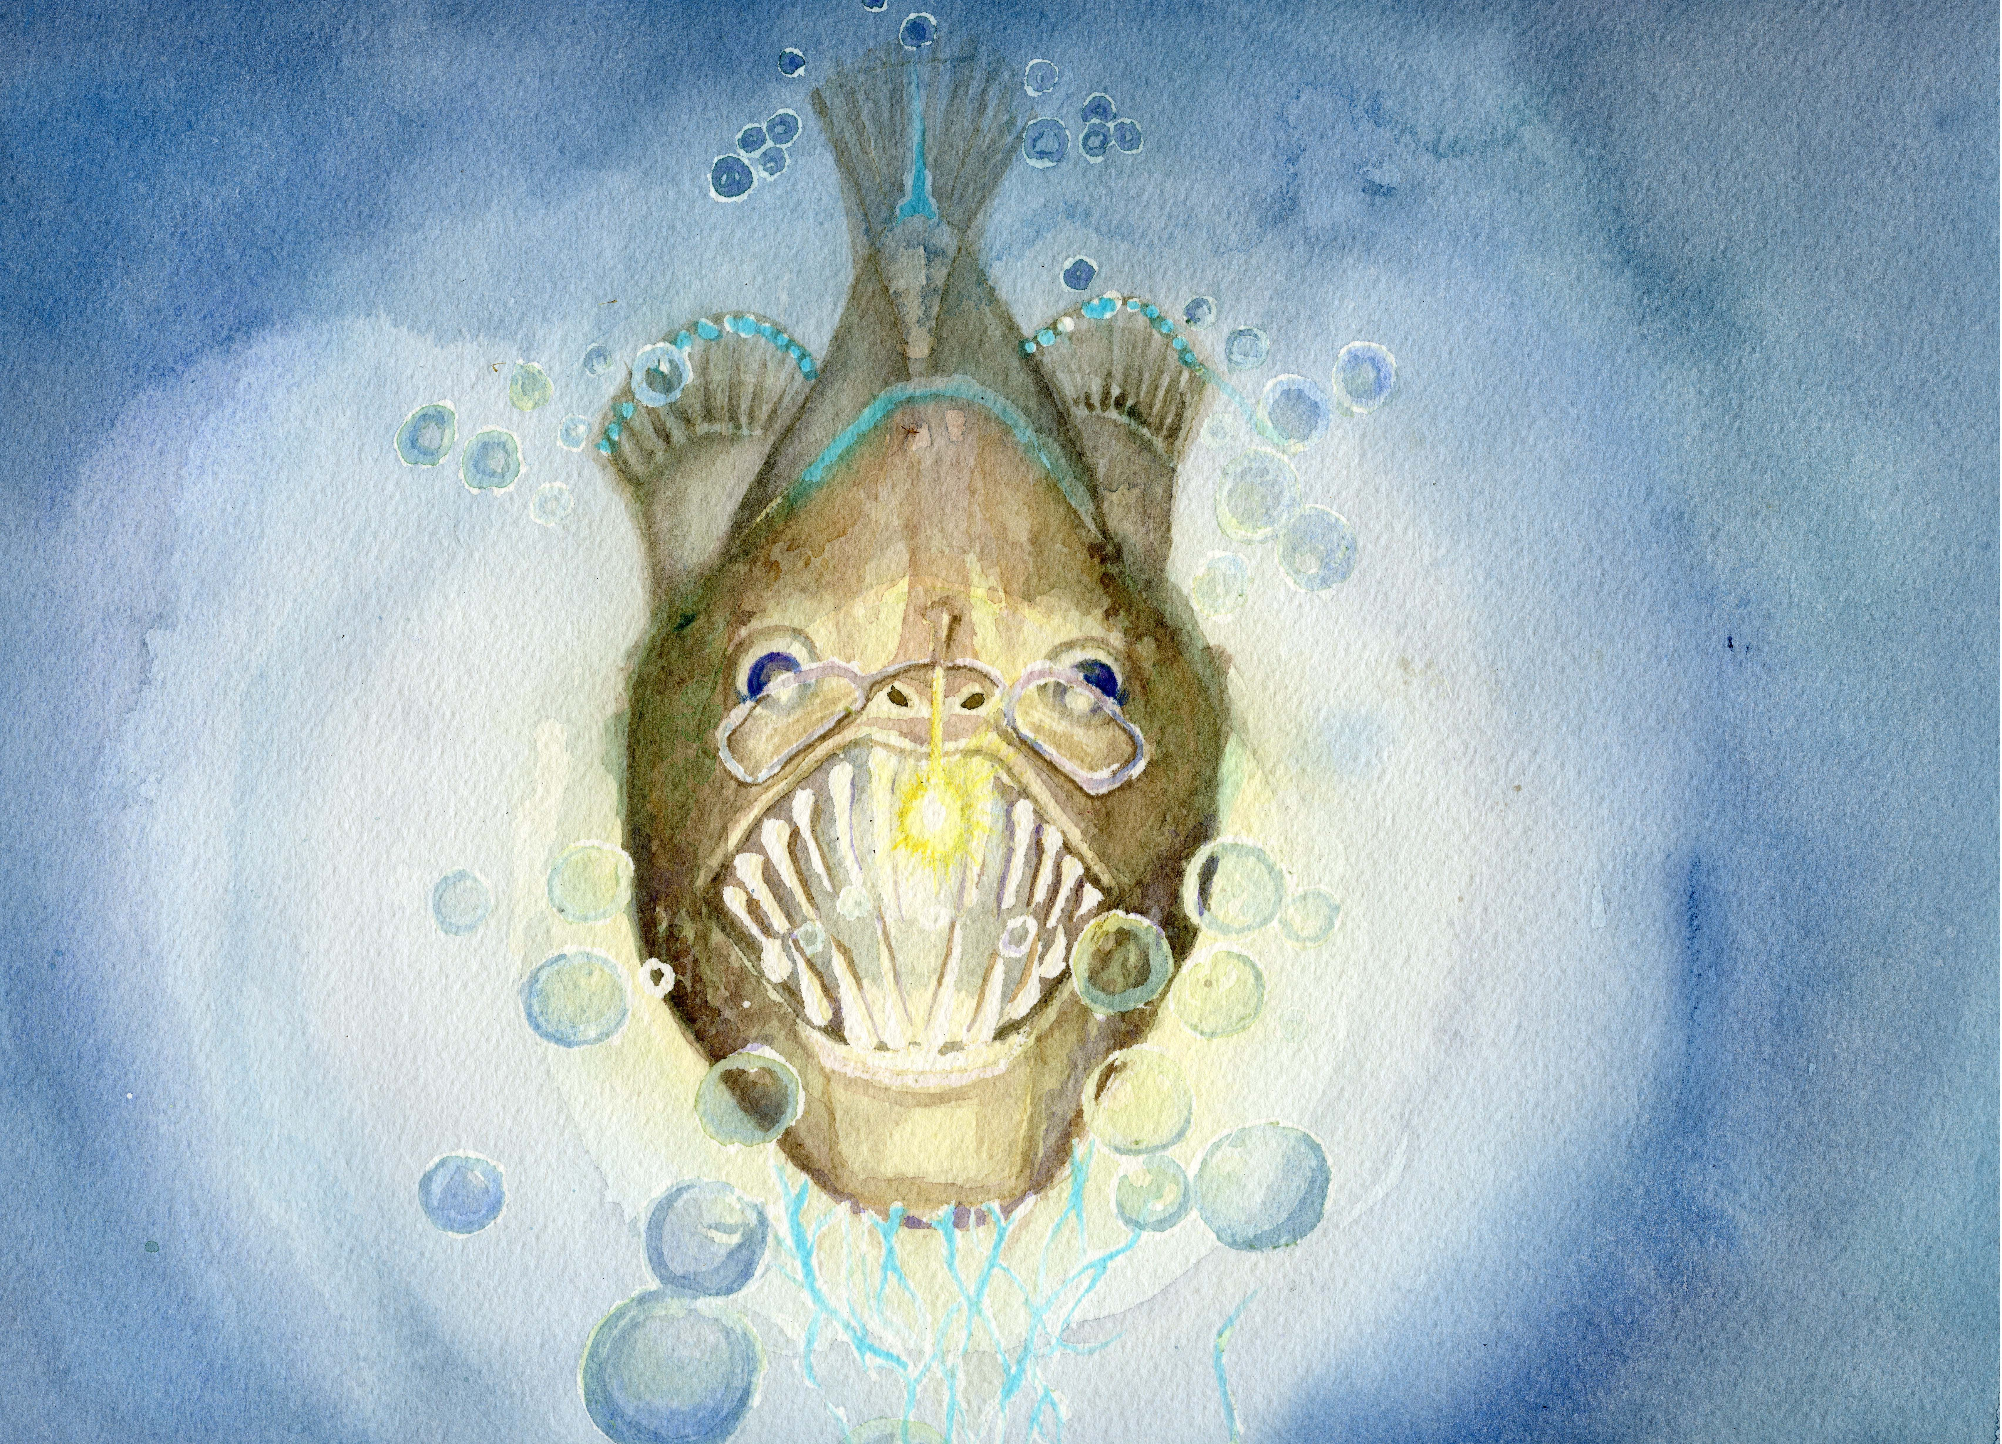

Slide 44
