Slide 1
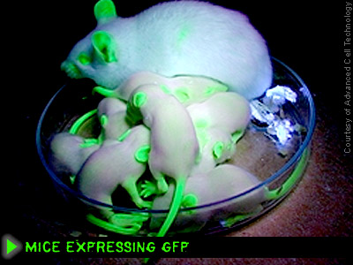
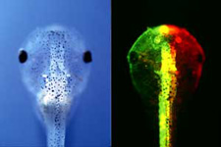
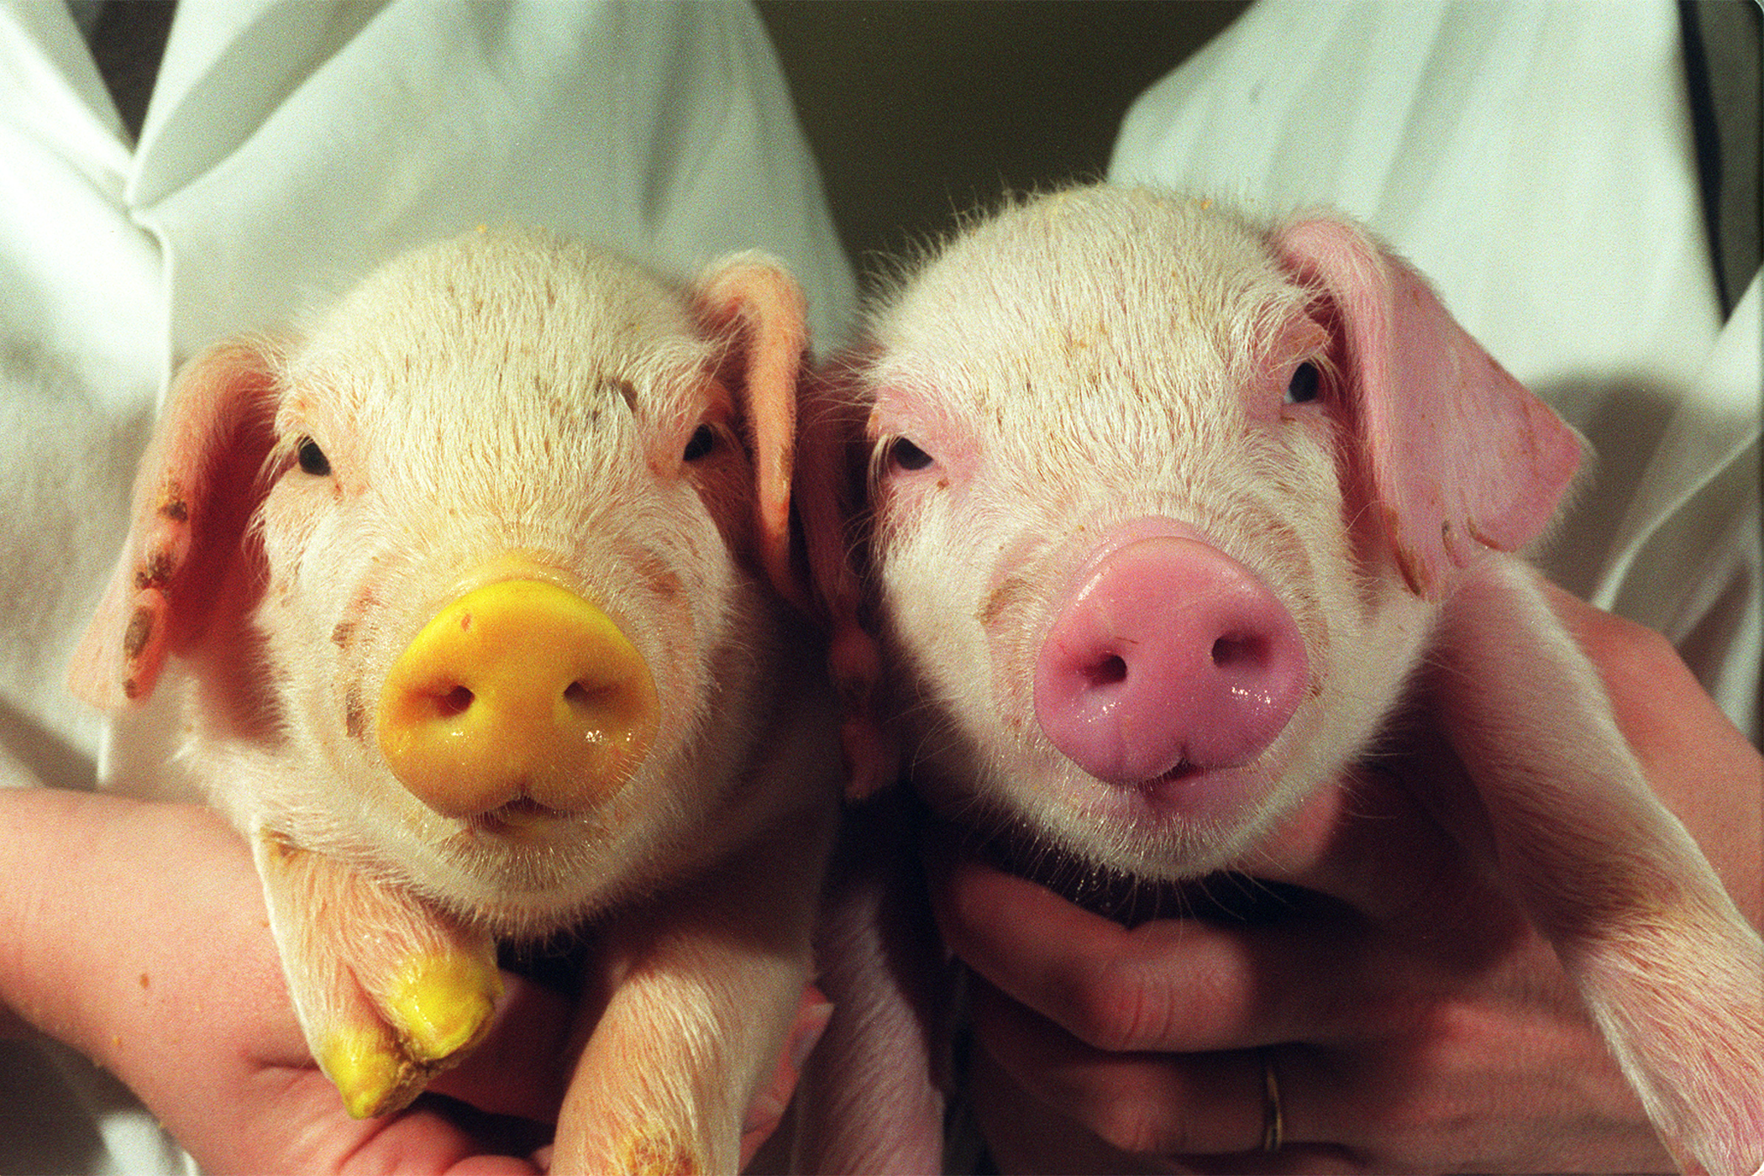
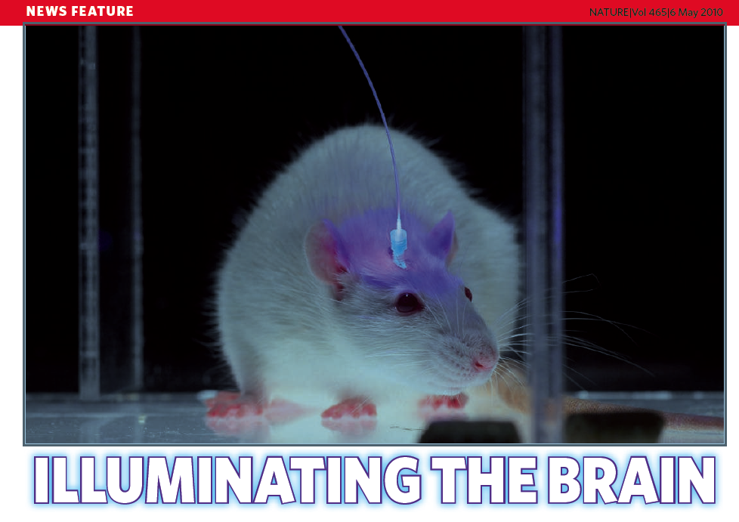
Mindreading/
Mindcontrol
Marc Zimmer
Connecticut College

Slide 2
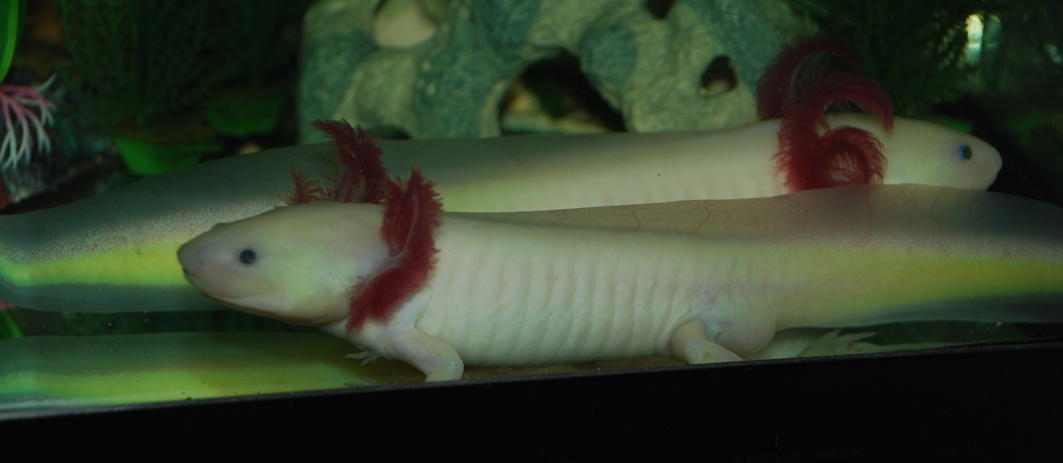
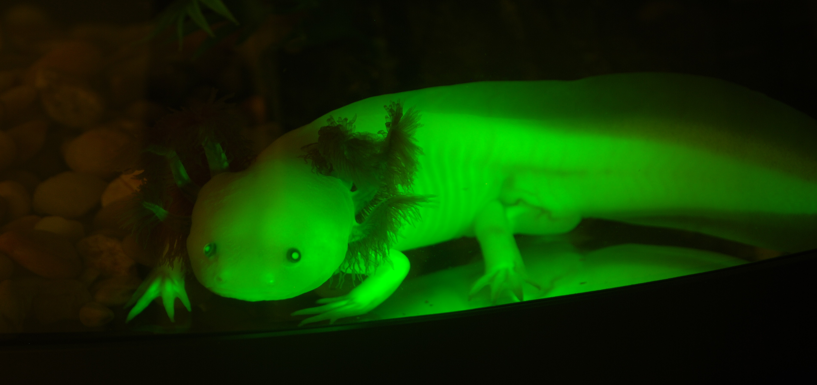

Slide 3
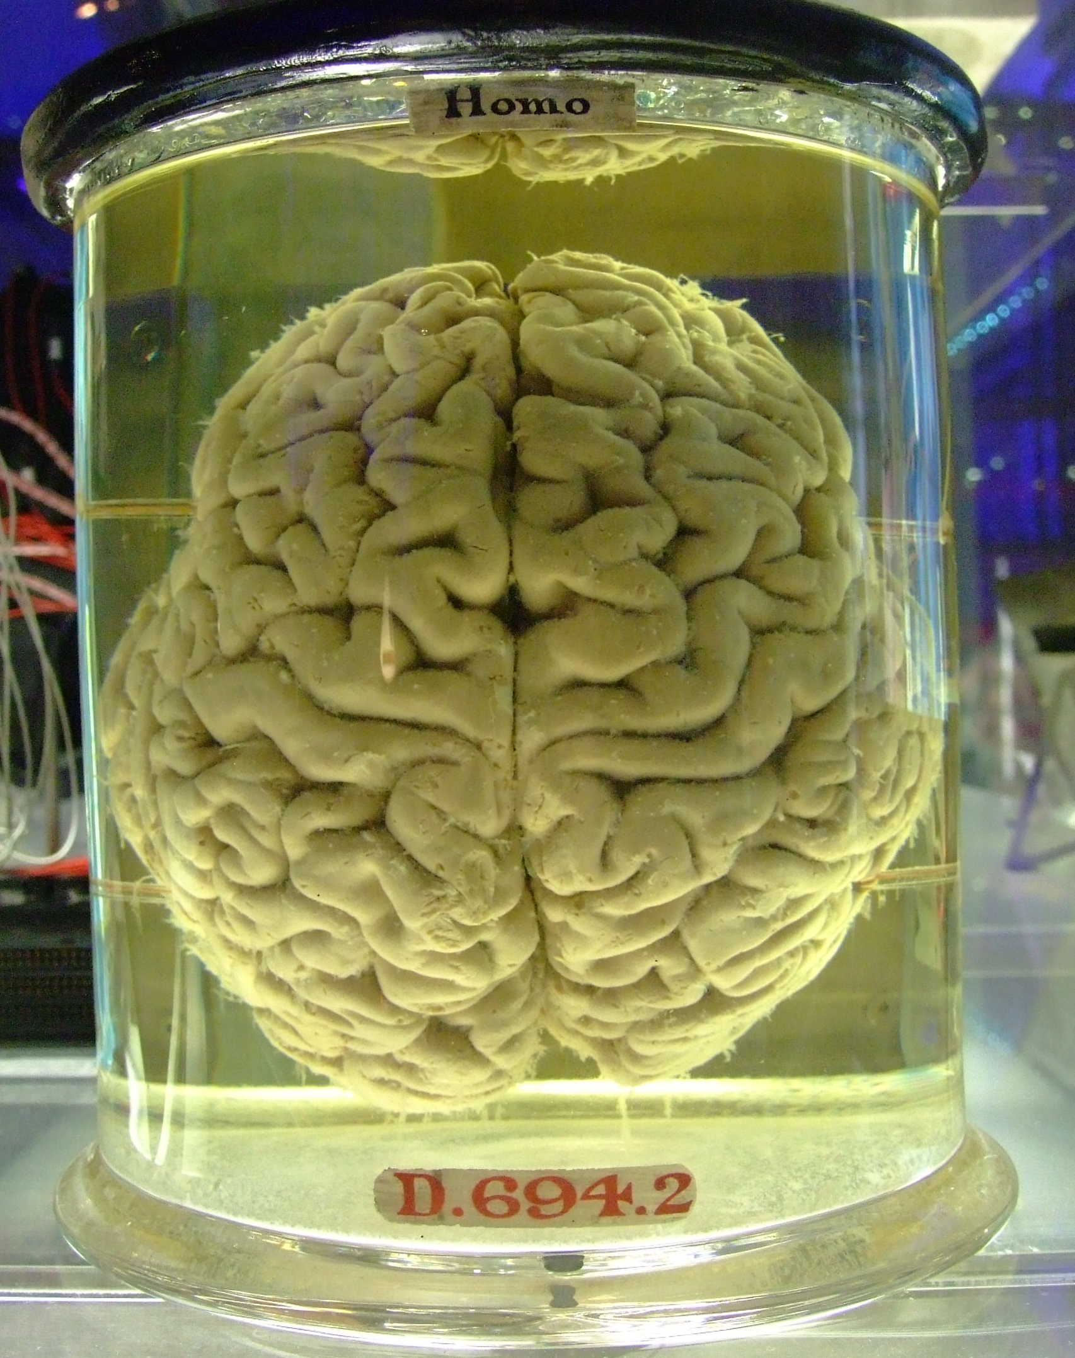

Slide 4
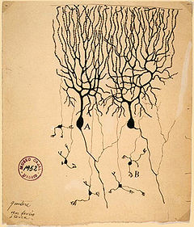
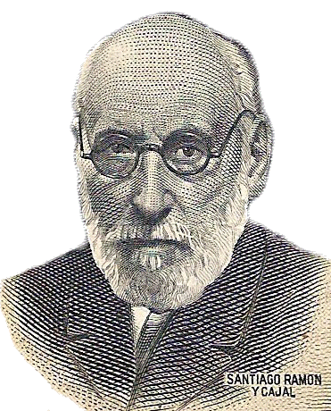
Drawing of Purkinje cells (A) and granule cells (B) from pigeon cerebellum by Santiago Ramón y Cajal, 1899.

Slide 5
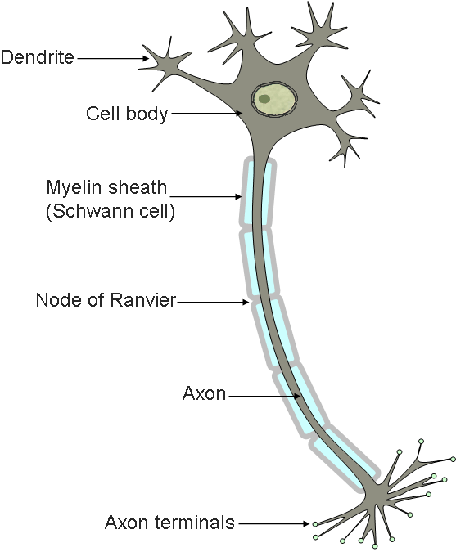

Slide 6
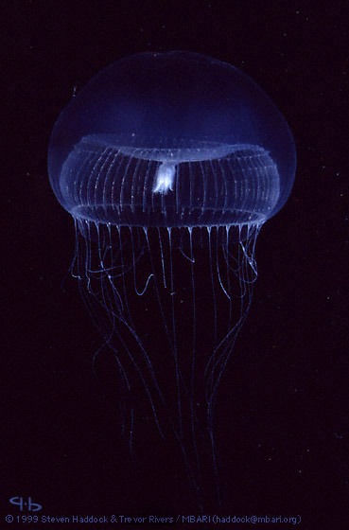
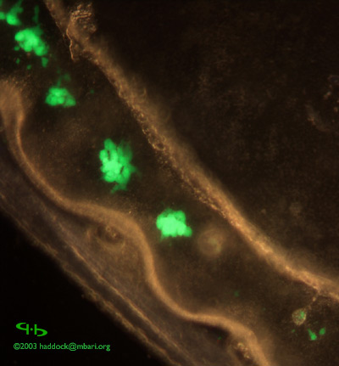

Slide 7
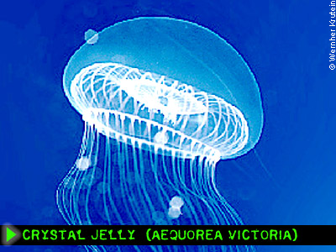

Ca2+
Aequorin
GFP

Slide 8
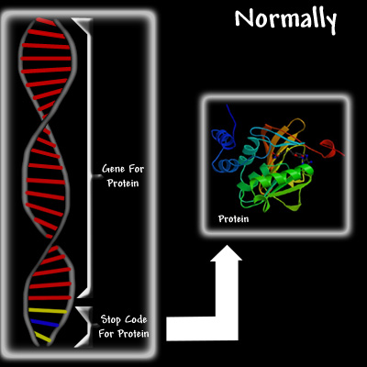
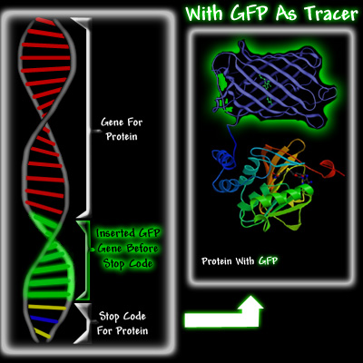

Slide 9
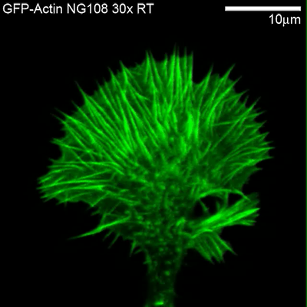

Slide 10
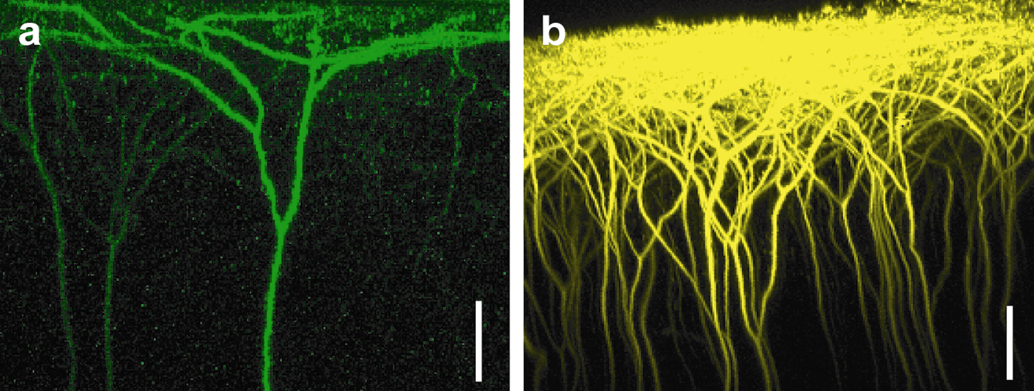
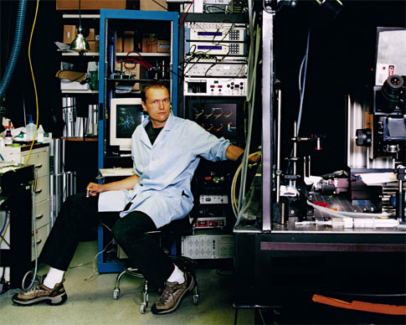

Slide 11
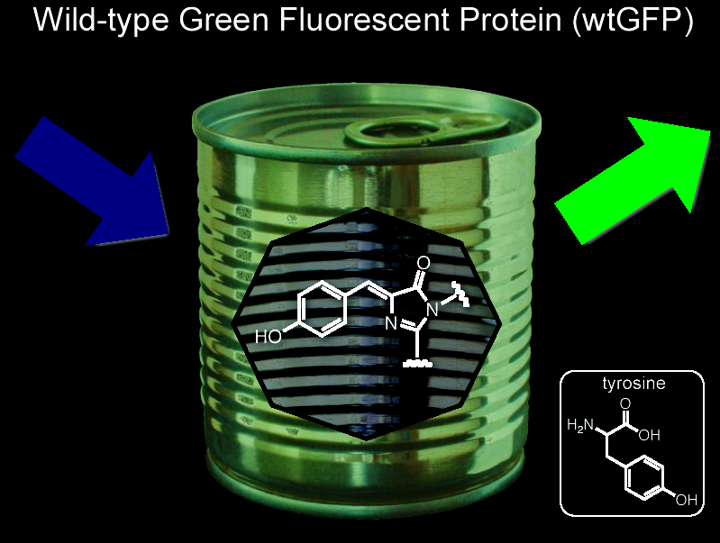

Slide 12
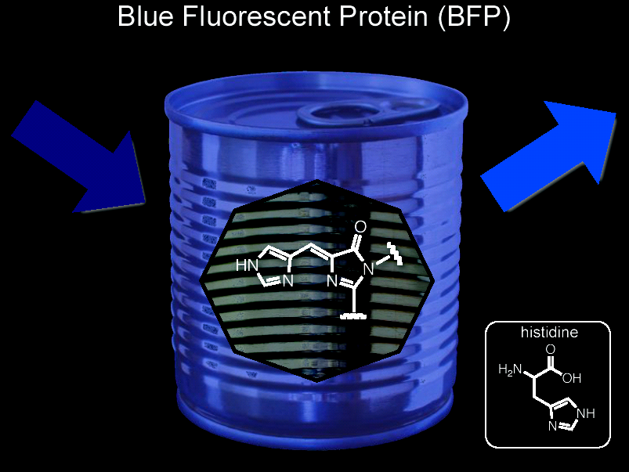

Slide 13
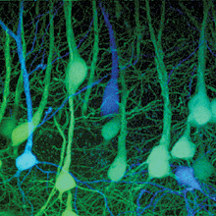

Slide 14
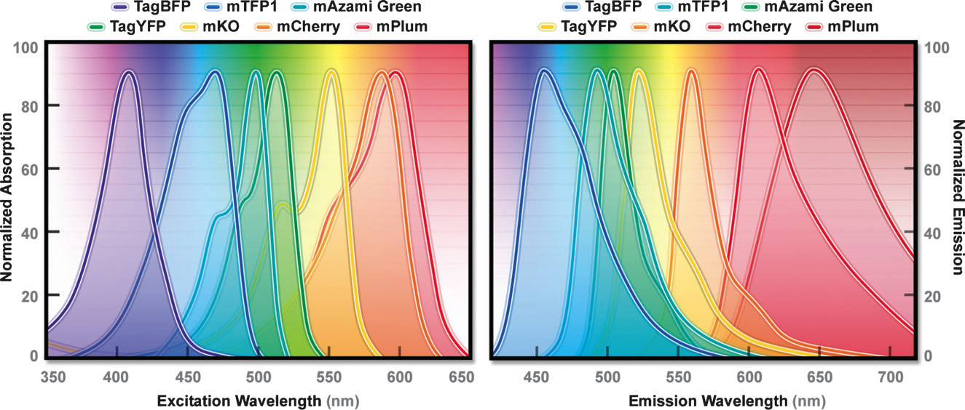
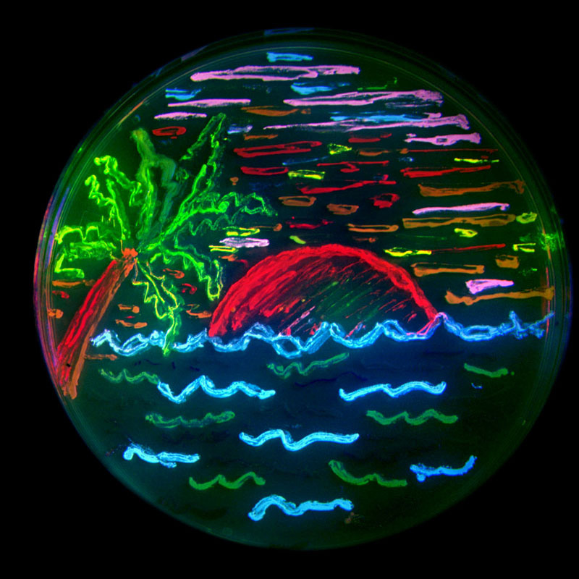
Davidson Chem Soc Rev 2009, 38, 2887
Credit: Tsien

Slide 15
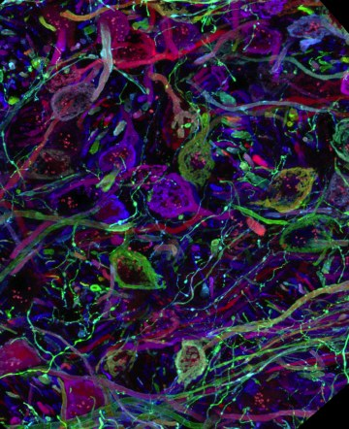
Confocal microscopy image from the brain stem, tube-like structures are axons of the auditory pathway ,
which are forming hand-shaped synapses on other neurons (here unlabeled). ( Confocal image by Jean Livet)

Slide 16
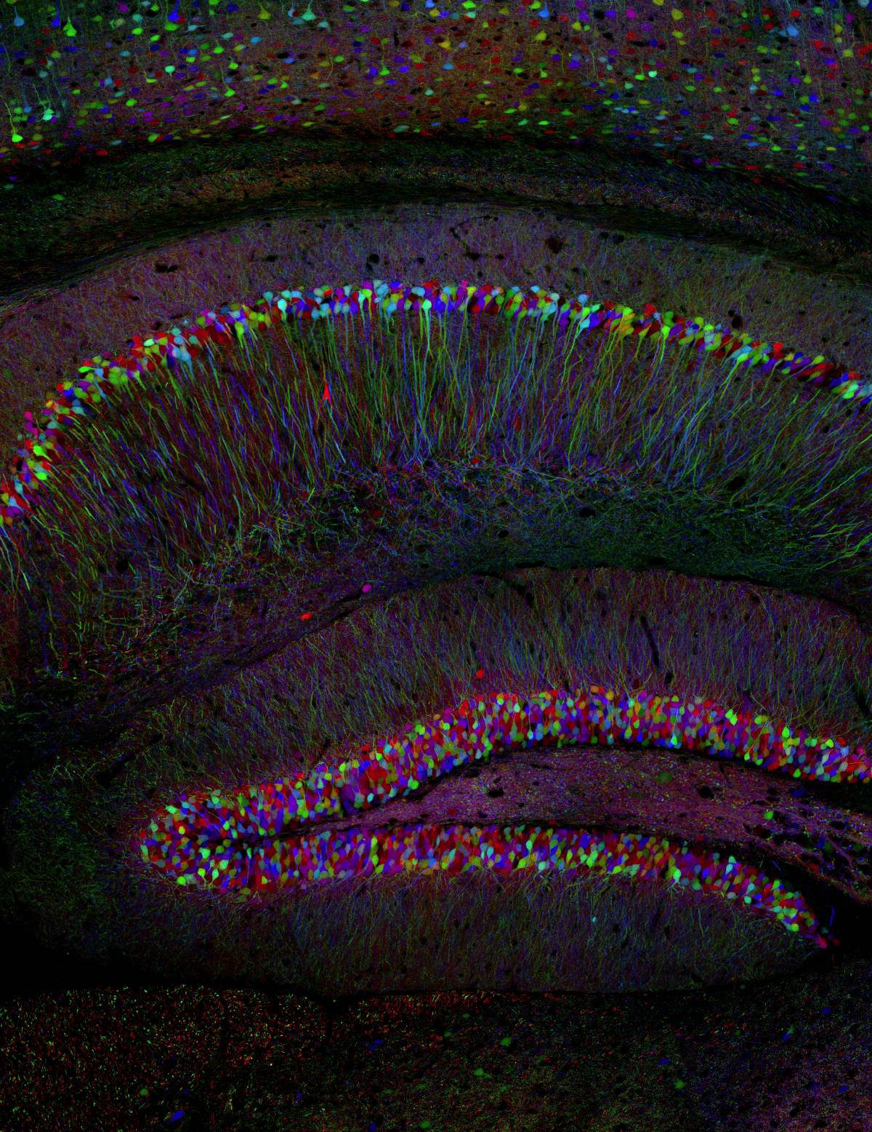
The cerebral cortex, which plays an important role in memory, perceptual awareness, thought and language.
(Confocal image by Tamily Weissman. Mouse by Jean Livet and Ryan Draft.)

Slide 17
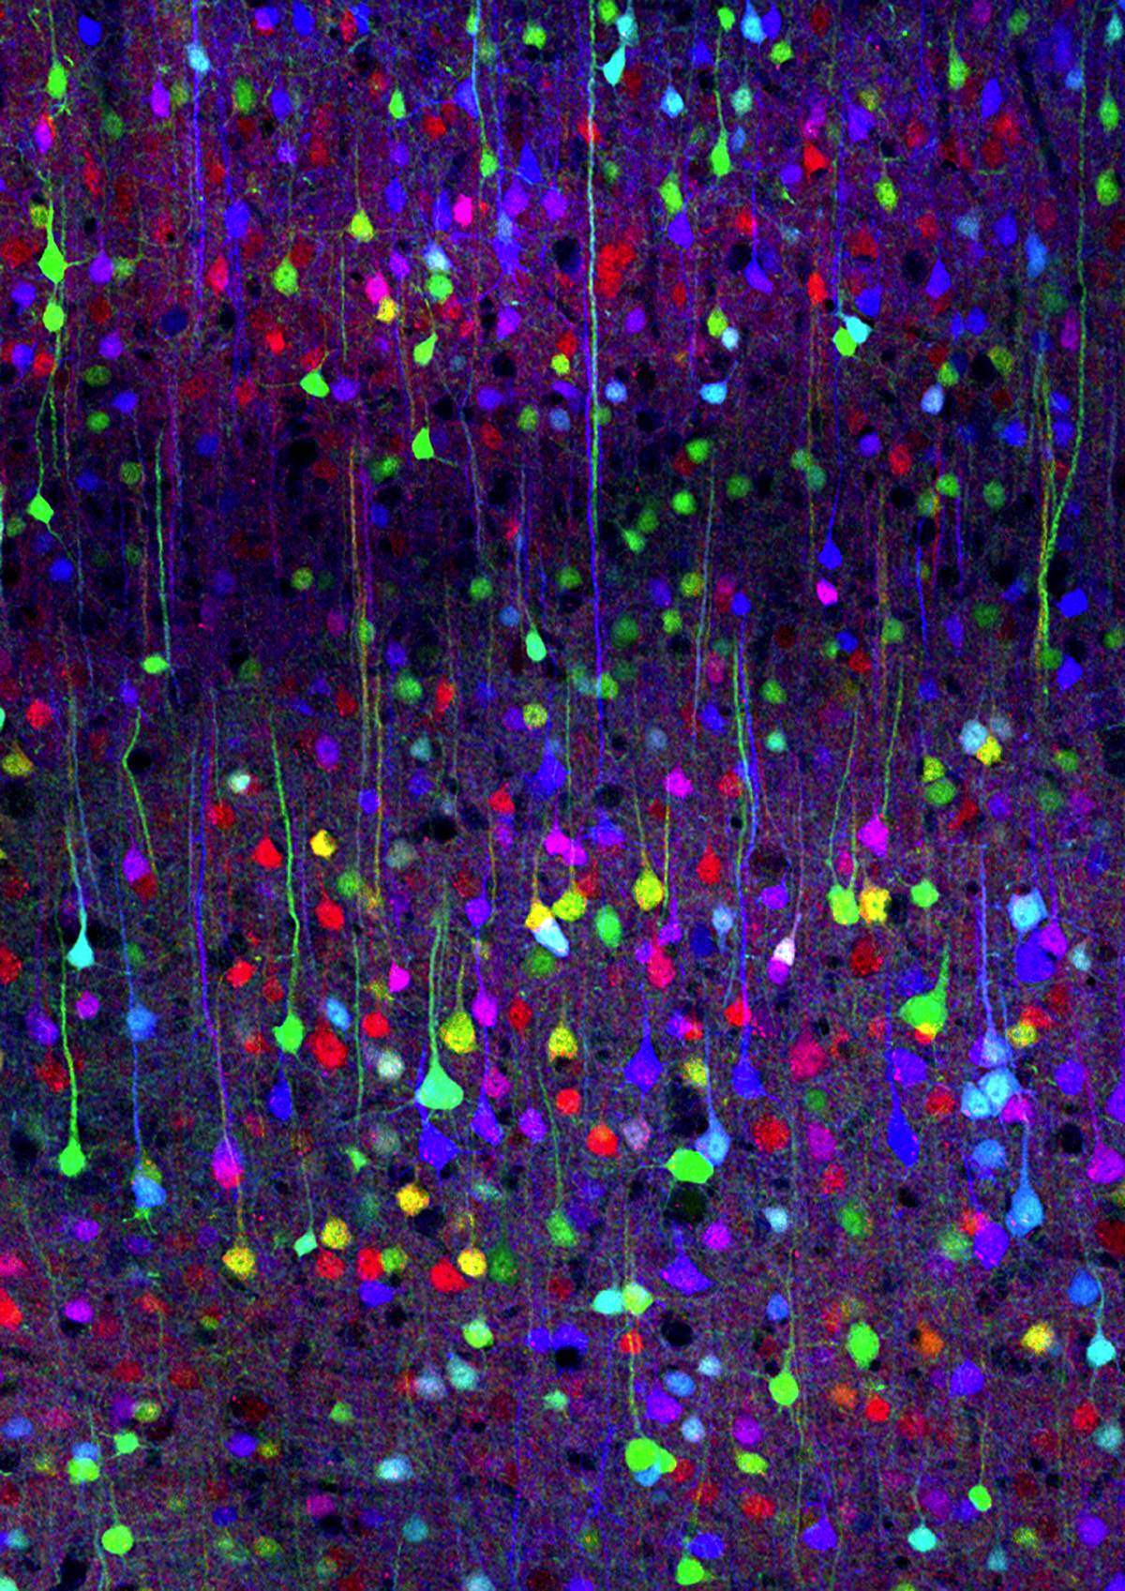
_{Cerebral cortex.}
(Confocal image by Tamily Weissman. Mouse by Jean Livet and Ryan Draft.)

Slide 18
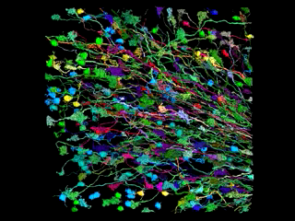

Slide 19
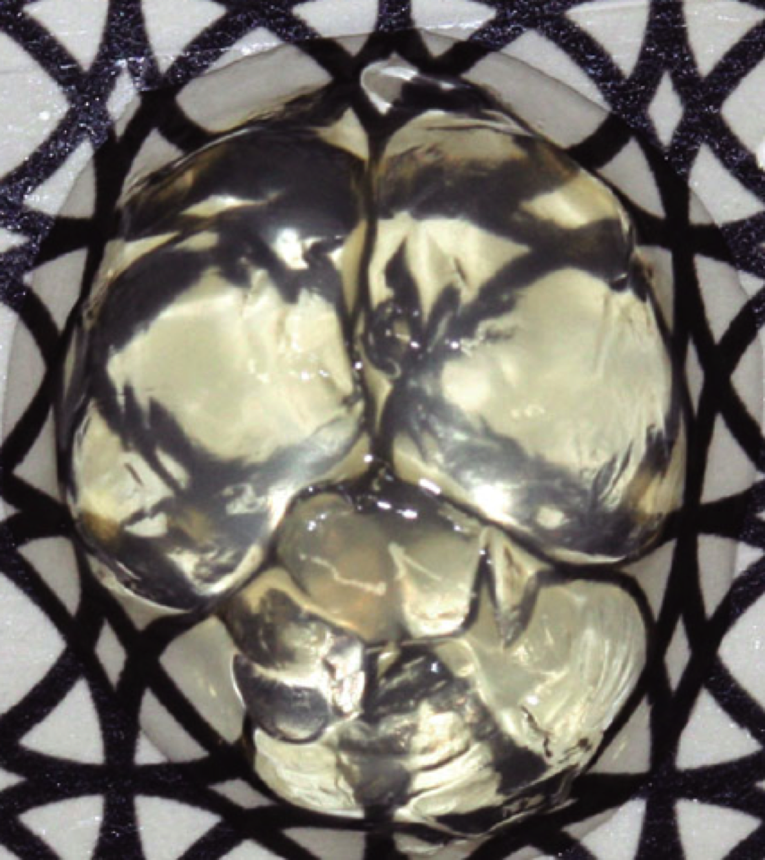

Slide 21
Nernst Equation
RT
nF
E = E° −
ln[prods]/[reacts]
0.0592
2
E = 0 −
Log [Ca²⁺]_{in}/[Ca²⁺]_{ou}

Slide 22
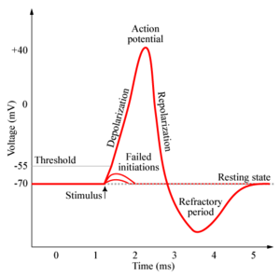

Slide 23
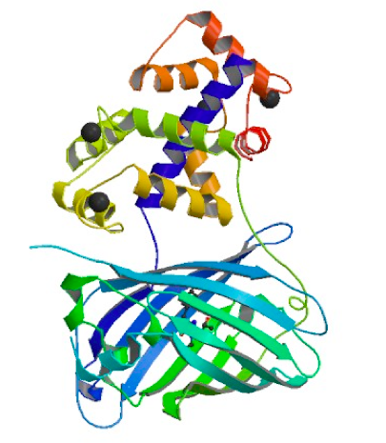

Slide 24
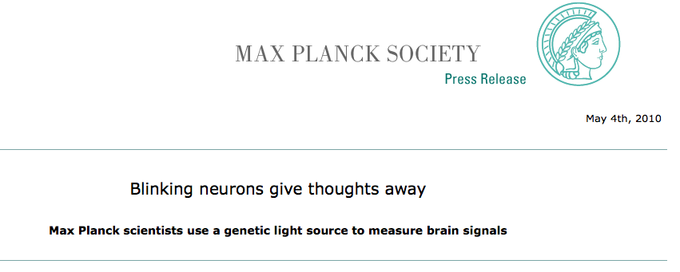

Slide 25
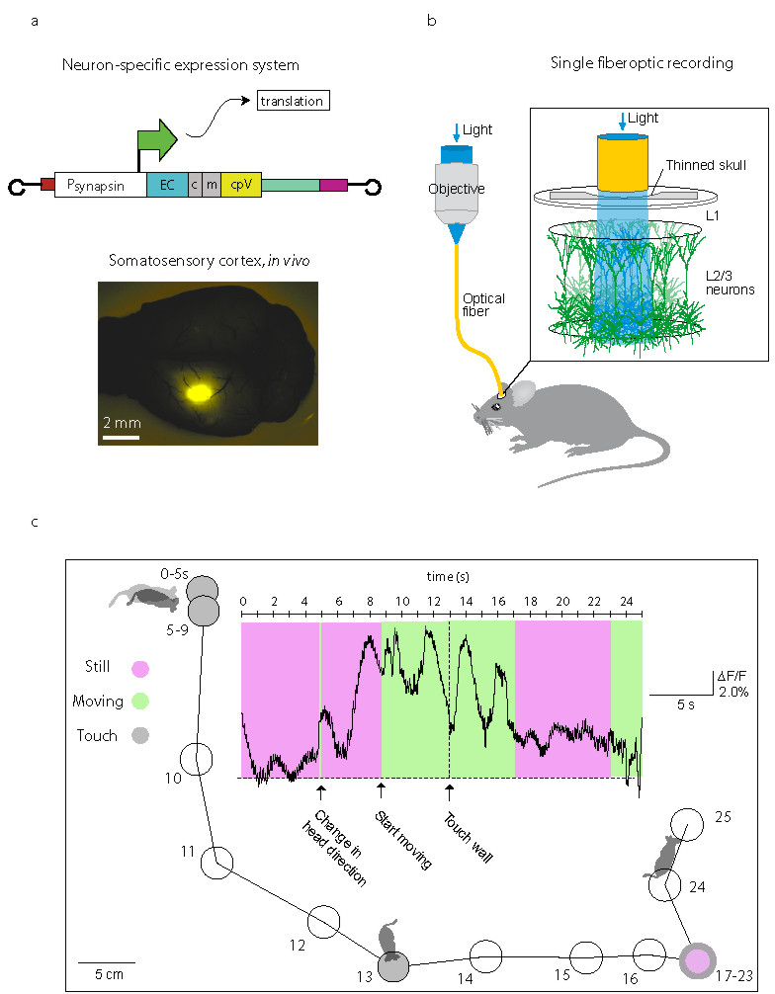

Slide 26
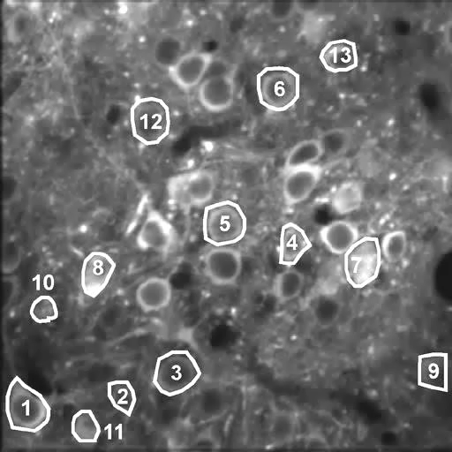
Neurons in the primary motor cortex that express the new genetically encoded calcium indicator GCaMP3 light up as they fire in sequence as the mouse moves a single whisker.

Slide 27
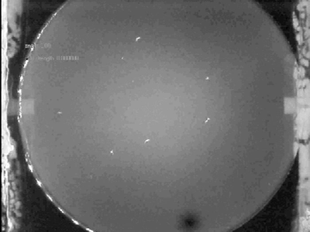

Slide 28
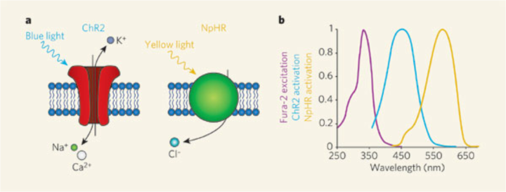
Deisseroth, Nature, 5 April 2007, 633

Slide 29
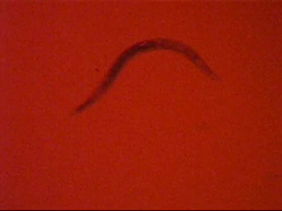

Slide 30
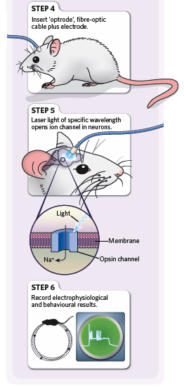
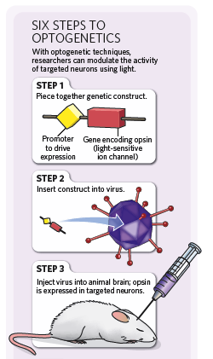

Slide 32
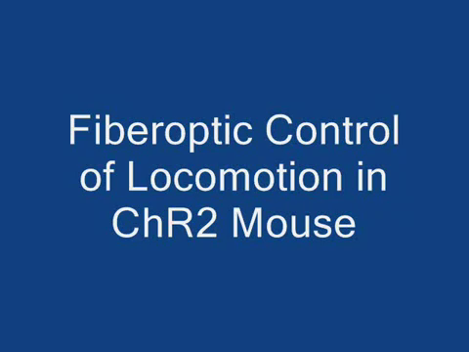

Slide 33


Slide 34

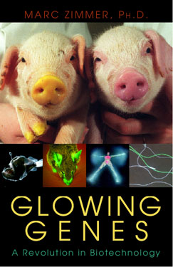
Green Fluorescent Protein
http://www.conncoll.edu/ccacad/zimmer/GFP-ww/GFP-1.htm

Slide 35
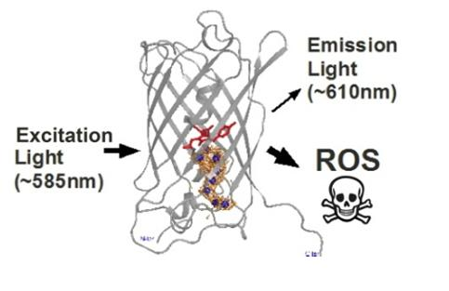
KillerRed

Slide 36


Slide 37
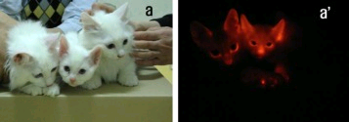

Slide 38
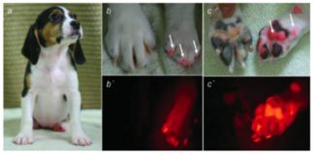

Slide 39
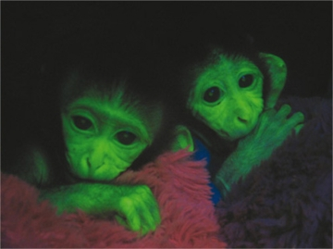

Slide 40
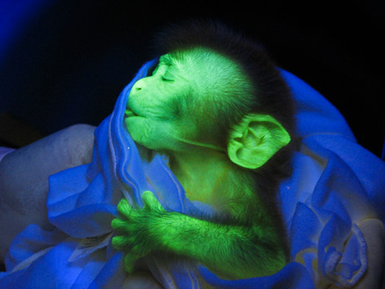

Slide 41
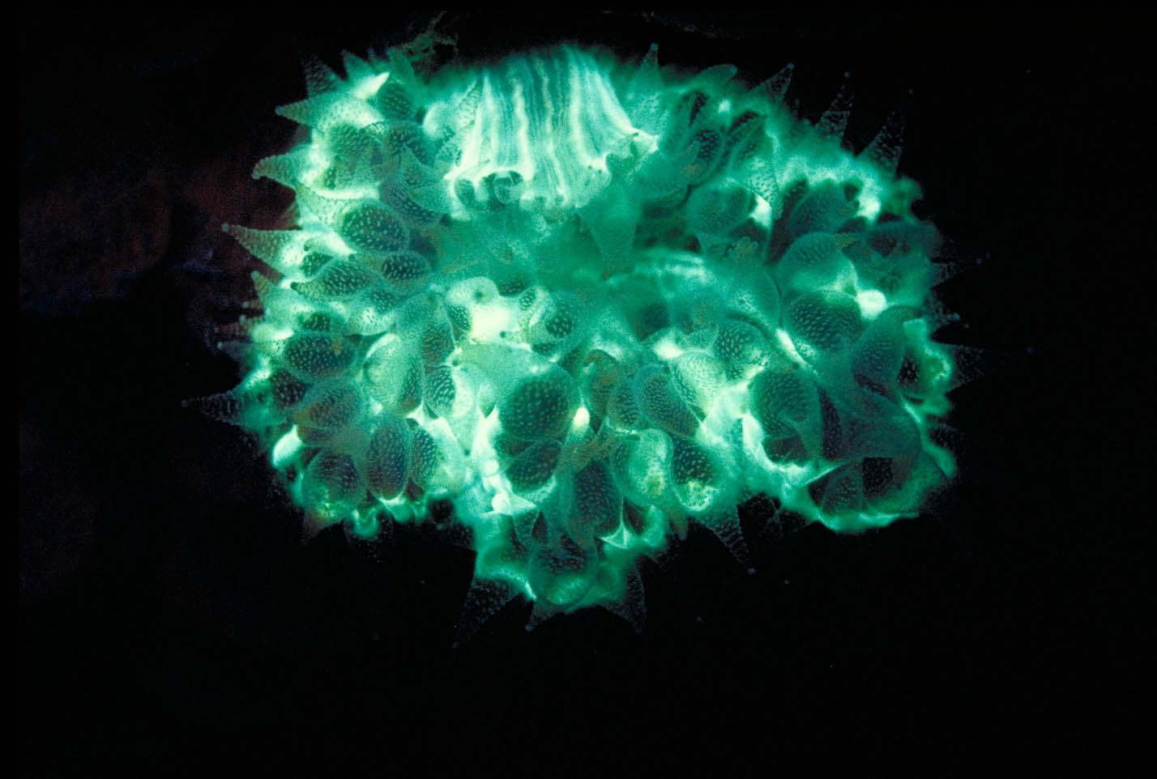
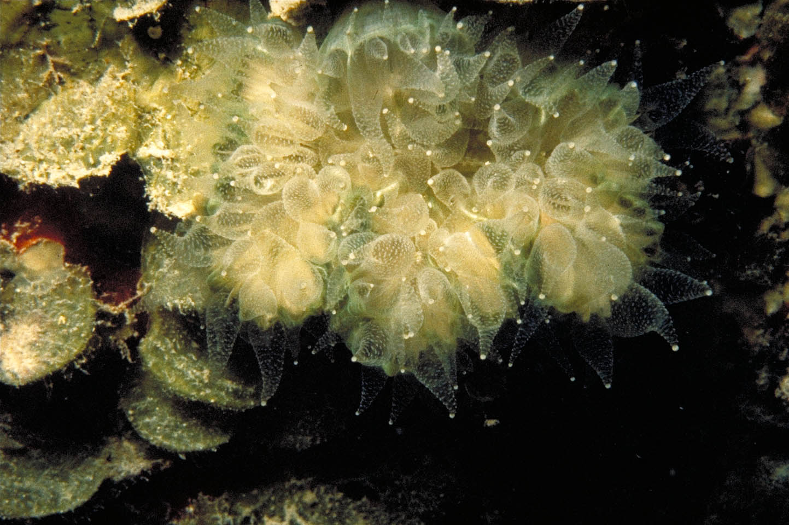

Slide 42
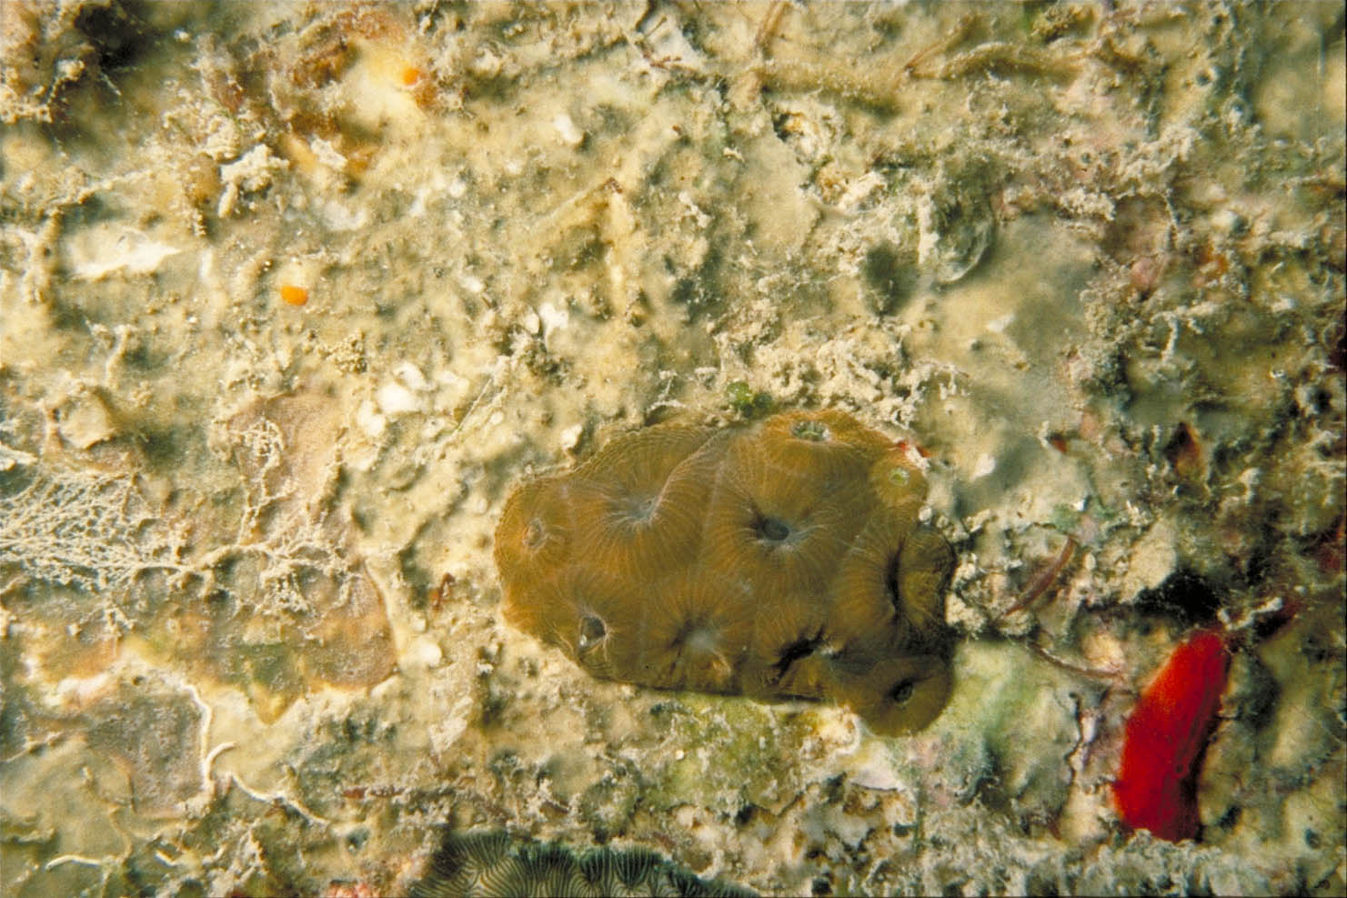
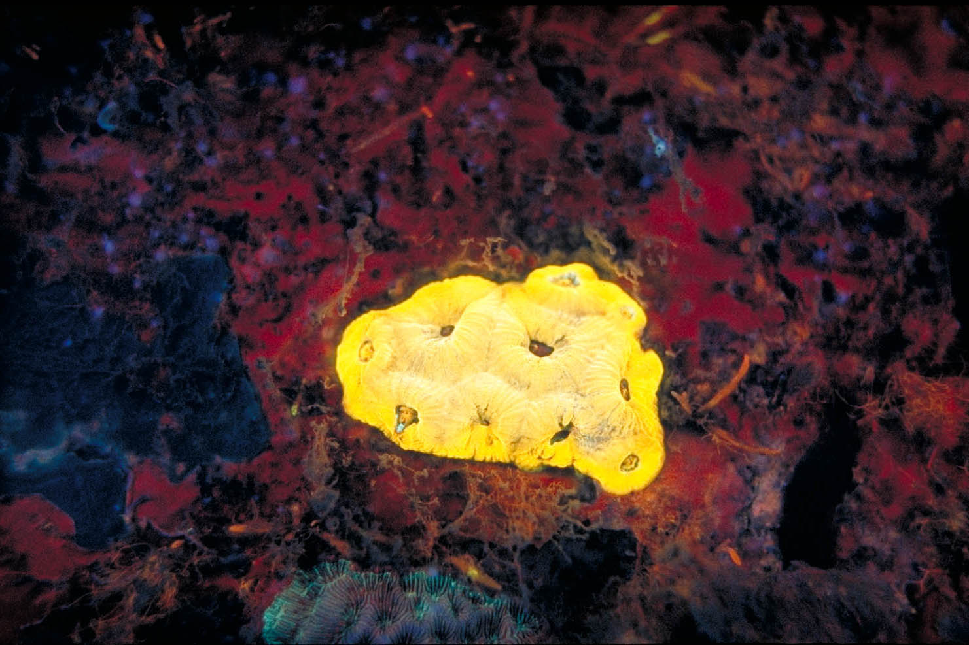

Slide 43
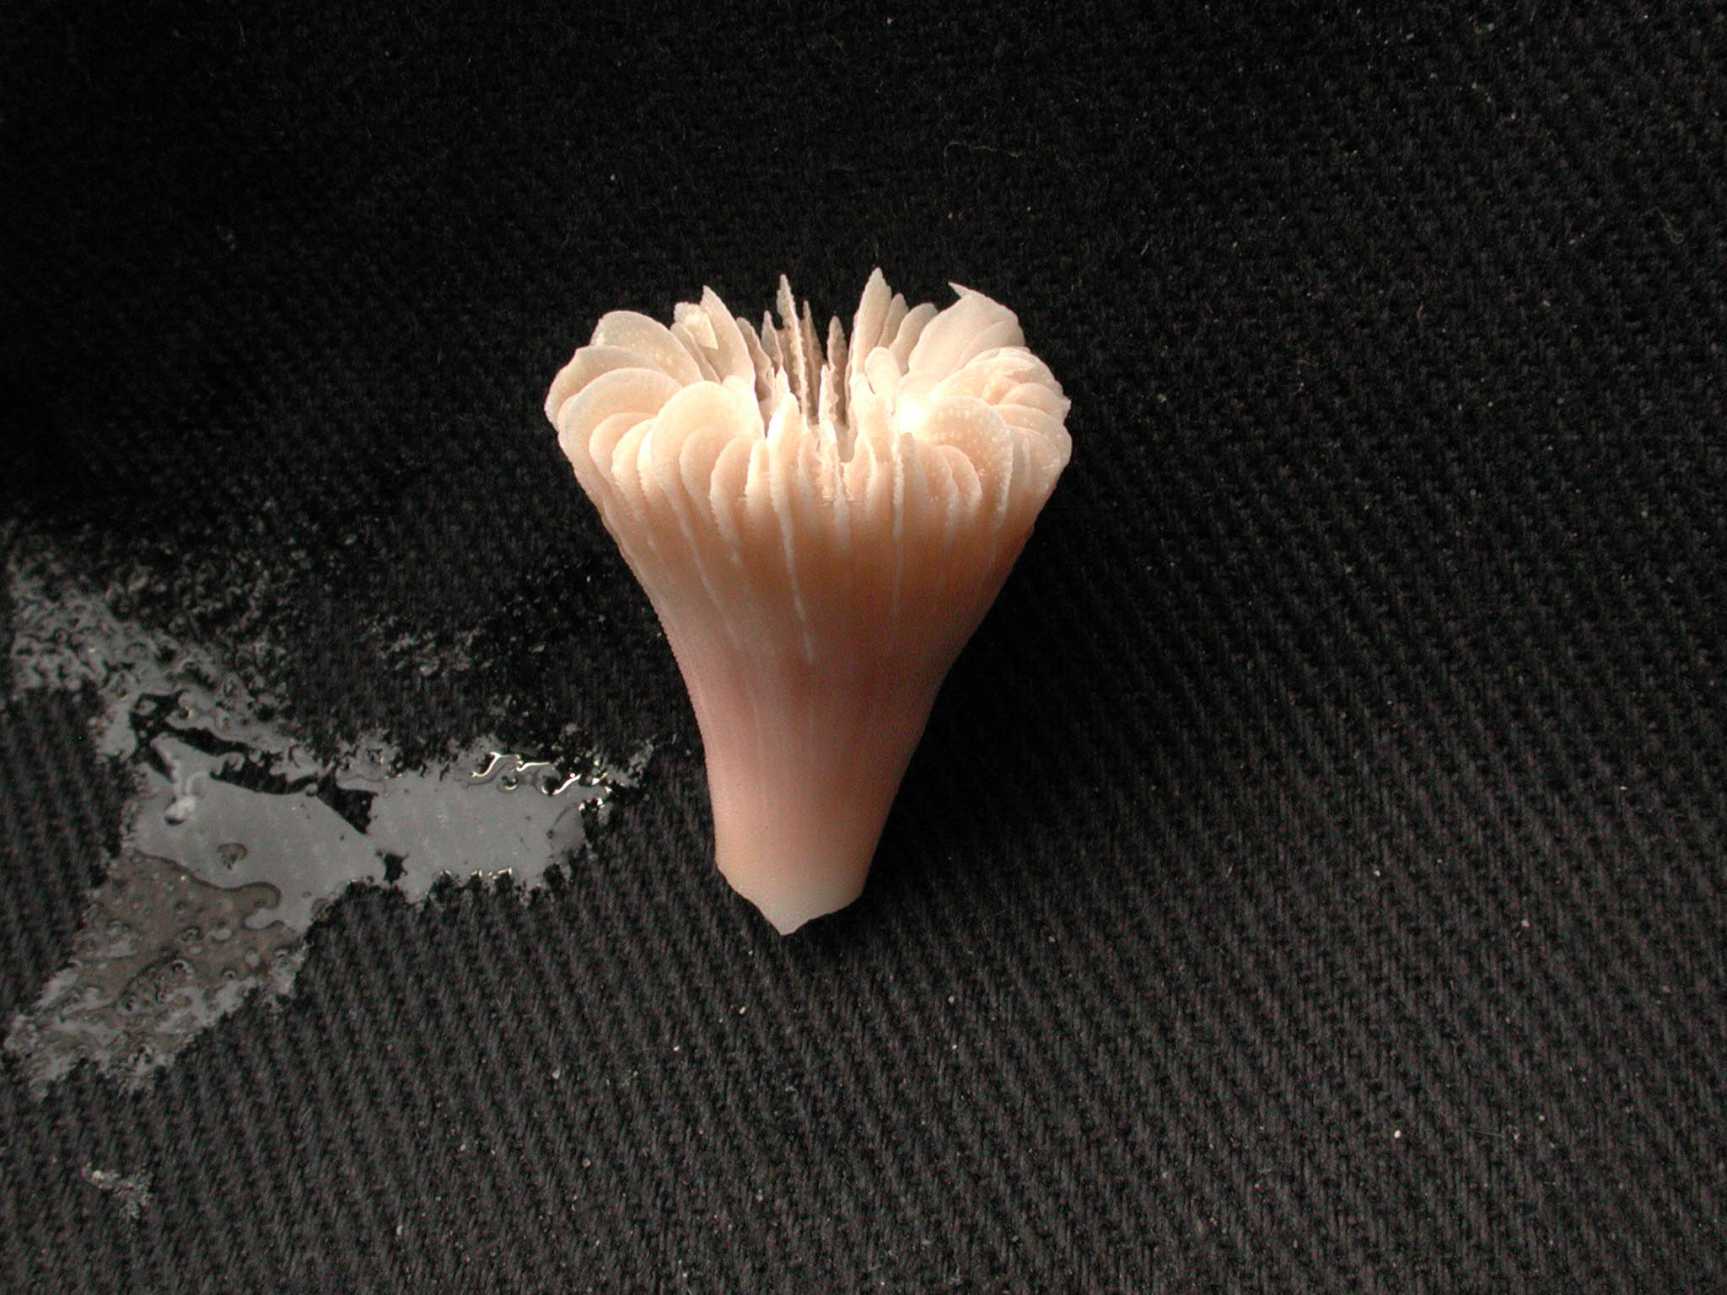

Exploring the Deep

Slide 44


Slide 45


Fluorescing Mantis Shrimp
Photograph courtesy of Roy Caldwell

